Slide 1
Advanced Dotnet
Parameswari

Slide 2
Goals
Collections
Generics
Delegates
Events
Lambda Expressions
LINQ Queries
Concurrency and Asynchrony
Parallel Programming

Slide 3
Collections
Collection are a set of classes that include data structure that store number of objects and provide operations to work with them as one entity.
Collection classes are either in the namespace
System.Collections
A collection of container classes that allows storage of any type of .NET objects
System.Collections.Generic
A collection of container classes that allows only specified type of objects.
In some cases, these classes perform better especially when storing value types.

Slide 4
Collection Classes Overview
Collection are a set of classes that include data structure that store number of objects and provide operations to work with them as one entity.
Collection classes are either in the namespace
System.Collections
A collection of container classes that allows storage of any type of .NET objects
System.Collections.Generic
A collection of container classes that allows only specified type of objects.
In some cases these classes perform better especially when storing value types.

Slide 5
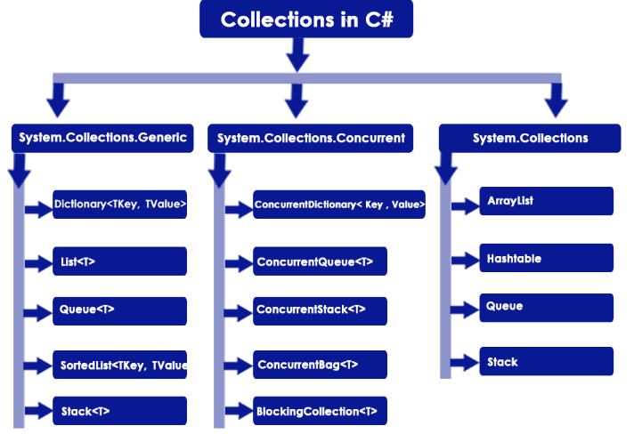
Collection Framework

Slide 6
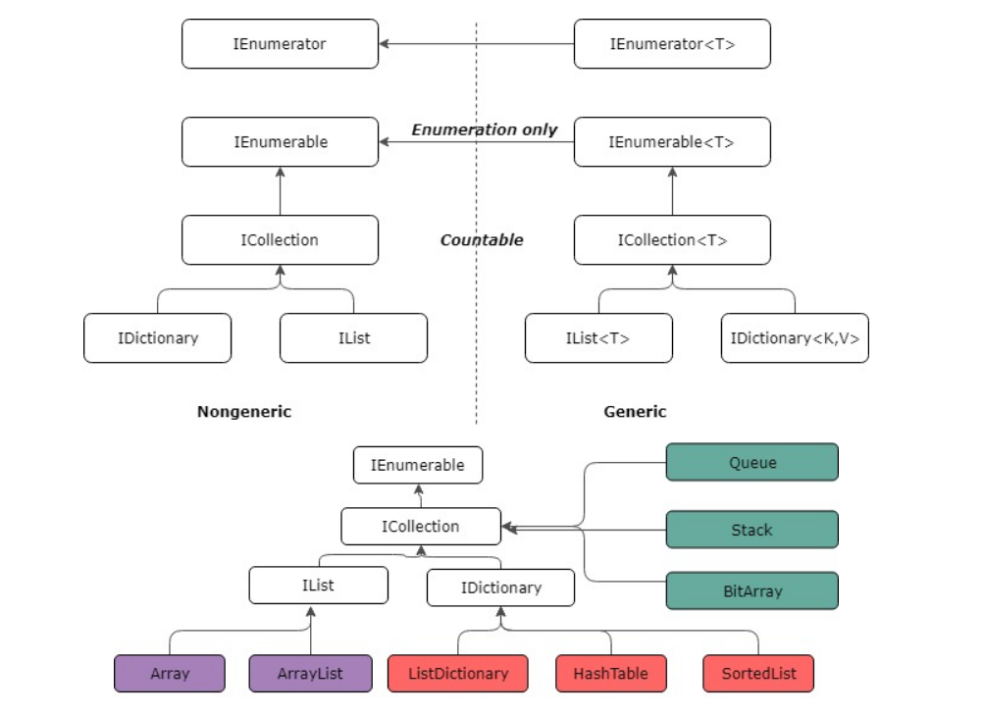
Collection Framework

Slide 7
Why collections?
.NET provide many types of collection classes that like classes implementing from ICollections and Arrays.
Also, the classes provide number of ways to store collection of objects – as List, as Map
Also, there are already methods that allow the entire collection of objects to be treated as one like sort, search etc.
Since all theses are already implemented and tested using these would save considerable amount of time.
Some collection classes are dynamic and so any number of object can be added to it without worry about overflow
foreach can be used to iterate through any collections.

Slide 8
Non-generic Interfaces
Most of the collection classes share common interfaces.
Collection Interfaces
ICollection
IList
IDictionary
Interface iterators/enumerators
IEnumerator and IEnumerable
IDictionaryEnumerator
Collections supports foreach statement for iteration. They are generally used instead of the above two since they are very convenient.

Slide 9
ICollection
ICollection interface is parent for all the other of non-generic interfaces – IList and IDictionary
It inherits from IEnumerable .
Members and their description in API:
Count: number of elements contained in the ICollection.
IsSynchronized: bool value indicating if the access to the ICollection is synchronized (thread safe).
SyncRoot: returns object that can be used to synchronize access to the ICollection
void CopyTo(Array array, int index ): Copies the elements of the ICollection to an Array, starting at a particular array index
IEnumerator GetEnumerator(): Returns an enumerator that iterates through a collection.

Slide 10
IList
Classes implementing IList is an interface that allow a list of any objects that can be individually accessed using index.
Implements ICollection, IEnumerable
Members and their description in API:
IsFixedSize: Gets a value indicating whether the IList has a fixed size.
IsReadOnly : Gets a value indicating whether the IList is read-only.
Item: Gets or sets the element at the specified index.
int Add ( Object value ) : Adds an item to the IList.
void Clear : Removes all items from the IList.

Slide 11
IList
bool Contains ( Object value ) : Determines whether the IList contains a specific value.
int IndexOf ( Object value ): Determines the index of a specific item in the IList.
void Insert ( int index, Object value ): Inserts an item to the IList at the specified index.
void Remove ( Object value ): Removes the first occurrence of a specific object from the IList.
void RemoveAt ( int index ): Removes the IList item at the specified index.

Slide 12
IDictionary
Classes implementing IDictionary allow non-generic collection of key/value pairs.
Implements ICollection, IEnumerable
Members and their description in API:
IsFixedSize : Gets a value indicating whether the IDictionary object has a fixed size.
IsReadOnly : Gets a value indicating whether the IDictionary object is read-only.
Item : Gets or sets the element with the specified key.
Keys : Gets an ICollection object containing the keys of the IDictionary object.

Slide 13
IDictionary
Values: Gets an ICollection object containing the values in the IDictionary object.
void Add: ( Object key, Object value ): Adds an element with the provided key and value to the IDictionary object.
void Clear (): Removes all elements from the IDictionary object.
bool Contains ( Object key): Determines whether the IDictionary object contains an element with the specified key.
IDictionaryEnumerator GetEnumerator (): Returns an IDictionaryEnumerator object for the IDictionary object.
void Remove (Object key): Removes the element with the specified key from the IDictionary object.

Slide 14
Recall
IEnumerator and IEnumerable

Slide 15
IDictionaryEnumerator
This interface is used to enumerate non-generic dictionary objects ( objects of type IDictionary)
Properties and their description in API:
Entry: Gets both the key and the value of the current dictionary entry.
Key: Gets the key of the current dictionary entry.
Value: Gets the value of the current dictionary entry.
Current: Gets the current element in the collection. (Inherited from IEnumerator.)
bool MoveNext() : Advances the enumerator to the next element of the collection. (Inherited from IEnumerator.)
void Reset() : Sets the enumerator to its initial position, which is before the first element in the collection.

Slide 16
Cautions about Enumerators
Enumerators can be used to read the data in the collection, but they cannot be used to modify the underlying collection.
Also if the underlying collection is changed while enumerating ( by another thread) , the enumerator is invalidated and the next call to MoveNext or Reset throws an InvalidOperationException.
In other words, enumerating through a collection is not thread-safe.
Even when a collection is synchronized, other threads can still modify the collection, which causes the enumerator to throw an exception.
Therefore it is recommended that a lock is obtained for the collection during while enumerating to make it thread-safe.
lock(collection.SyncRoot){
foreach(var item in collection){
// do stuff }}

Slide 17
List of collection classes
We are going to look at the following collection classes
Classes directly inheriting from ICollection
BitArray
Stack
Queue
Classes directly inheriting from IList
ArrayList
Classes directly inheriting from IDictionary
Hashtable
SortedList

Slide 18
BitArray Class
This class holds an array of bit values which are represented as System.Boolean.
The true indicates bit value 1 and false indicates the bit value 0.
Implements ICollection, IEnumerable, ICloneable
The size of a BitArray is specified and index beyond the size will throw an ArgumentException.
The instance methods in this class are not thread safe.
Even if the collection is synchronized, threads can modify the collection, which may causes the enumerator to throw an exception.
To guarantee thread safety during enumeration, either collection itself has to be locked while enumerating or exceptions (that is thrown because changes made by other threads) can be caught.

Slide 19
Constructors
BitArray (Int32 length, Boolean defaultValue): holds the specified number of bit values which are initially set to the specified value.
BitArray( int length ): holds the specified number of bit values, which are initially set to false.
BitArray (Boolean[] value) :contains bit values copied from the specified array of Booleans.
BitArray (Byte[] value) : contains bit values copied from the specified array of bytes. 1 is represented as True False False False False False False False, 2 is False True False False False False False False and so on
BitArray (Int32[] values): Similar to above, the bit values are copied from the specified array of 32-bit integers.
BitArray (BitArray): Copy constructor that clones the BitArray passed

Slide 20
BitArray member description in API
Apart from the methods of the interfaces that BitArray implements, other useful methods are –
BitArray Not() : Inverts all the bit values in the current BitArray, so that elements set to true are changed to false, and elements set to false are changed to true.
BitArray Or(BitArray value):Performs the bitwise OR operation on the elements in the current BitArray against the corresponding elements in the specified BitArray
BitArray Xor(BitArray value): Performs the bitwise exclusive OR operation on the elements in the current BitArray against the corresponding elements in the specified BitArray.
In the above methods both the BitArray must have same sizes.

Slide 21
BitArray member description in API
void SetAll(bool value): Sets all bits in the BitArray to the specified value.
void Set(int index, bool value ) :Sets the bit at a specific position in the BitArray to the specified value
bool Get( int index ): Gets the value of the bit at a specific position in the BitArray.

Slide 22
Example: BitArray
This example asks the user 4 (true/false) questions and compares the answers that user enters with the actual answers to calculate the marks.
using System;
using System.Collections;
public class BitArrayEx{
public static void Main() {
string[] questions = { "C# is object oriented language", "System.Collection is generic", "Threading is not supporterd by C#", "delegates are like function pointers" };
BitArray correctAns = new BitArray(new Boolean[] { true, false, false, true });
BitArray userAns = new BitArray(4, true);
Console.WriteLine("answer t for true and f for false");

Slide 23
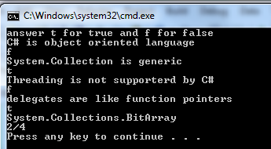
Example: BitArray
for (int j = 0; j < questions.Length; j++) {
Console.WriteLine(questions[j]);
string read = Console.ReadLine();
if (read.ToLower().Equals("f"))
userAns.Set(j, false);
}
BitArray result = correctAns.Xor(userAns);
Console.WriteLine(result);
int count = 0;
foreach (Boolean b in result) {
if (b == false) count++;
}
Console.WriteLine("{0}/4 ", count); }}

Slide 24
Stack Class
Represents a simple last-in-first-out (LIFO) non-generic collection of objects
Implements ICollection, IEnumerable, ICloneable
The capacity of a Stack is the number of elements the Stack can hold.
It is a dynamic collection in the sense that when elements are added to a it, its capacity is automatically increased if required through reallocation.
It is implemented as a circular buffer.
Stack accepts nothing (null) as a valid value .

Slide 25
Constructors
Stack(): empty with default initial capacity.
Stack(Int32): empty with specified initial capacity or the default initial capacity, whichever is greater.
Stack(ICollection): contains elements copied from the specified collection and has the same initial capacity as the number of elements copied.

Slide 26
Members
Members (apart from the interface methods)
public virtual Object Peek (): Returns the object at the top of the Stack without removing it.
virtual Object Pop (): Removes and returns the object at the top of the Stack.
public virtual void Push ( Object obj ): Inserts an object at the top of the Stack.

Slide 27
Example: Stack
This example evaluates the value of expression for a given postfix expression.
using System;
using System.Collections;
class StackEx {
public static void Main(){
//Postfix for (((1 + 2) * 3) + 6)/5
string expression = "12+3*6+5/";
int sum=0;
Stack s= new Stack();
char []chars=expression.ToCharArray();

Slide 28
foreach (char c in chars){
switch(c){
case '+':
sum = (int)s.Pop() + (int)s.Pop(); s.Push(sum); break;
case '-':
sum = (int)s.Pop() - (int)s.Pop();
s.Push(sum); break;
case '*':
sum = (int)s.Pop() * (int)s.Pop();
s.Push(sum); break;
case '/':
int i1 = (int)s.Pop();
int j1 = (int)s.Pop();
sum = j1/i1; s.Push(sum); break;
default:
int i = c - '0';
s.Push(i); break; }}
Console.WriteLine("sum is {0}",(int)s.Pop());
}}

Slide 29
Queue Class
Represents a first-in, first-out collection of objects.
Implements ICollection, IEnumerable, ICloneable
It is also implemented as a circular array.
Objects stored in a Queue are inserted at rear and removed from the front .
The behavior of the Queue is also similar to Stack when it come to capacity and reallocation while elements are added.
Queue accepts Nothing (null) as a valid value .
The constructors of Queue are similar to one in Stack.

Slide 30
Members
Members (apart from the interface methods)
public virtual Object Dequeue () Removes and returns the object at the beginning of the Queue.
public virtual void Enqueue ( Object obj ): Adds an object to the end of the Queue
public virtual Object Peek (): Returns the object at the beginning of the Queue without removing it.

Slide 31
ArrayList Class
ArrayList is an array whose size is dynamically increased as required.
Implements the IList , ICollection, IEnumerable, ICloneable
This class provides several methods like sort and search.
The ArrayList by itself is not sorted. Hence before calling binary search methods it must be sorted.
The capacity can be decreased by calling TrimToSize or by setting the Capacity property explicitly.

Slide 32
Constructors
ArrayList(): empty list with default initial capacity.
ArrayList(Int32 capacity): empty list with specified initial capacity.
ArrayList(ICollection coll) : contains elements copied from the specified collection and that has the same initial capacity as the number of elements copied.

Slide 33
Members
void Reverse(): Reverses the order of the elements in the entire ArrayList.
void Reverse(Int32, Int32): Reverses the order of the elements in the specified range.
static ArrayList ReadOnly(ArrayList): Returns a read-only ArrayList wrapper.
static ArrayList ReadOnly(IList): Returns a read-only IList wrapper.
void AddRange(ICollection c): Adds the elements of an ICollection to the end of the ArrayList.
void TrimToSize() :Sets the capacity to the actual number of elements in the ArrayList.

Slide 34
Members
static ArrayList Synchronized(ArrayList list), static ArrayList Synchronized(IList list): Returns a list wrapper that is synchronized (thread safe).
Capacity : Gets or sets the number of elements that the ArrayList can contain.
IsFixedSize : Gets a value indicating whether the ArrayList has a fixed size.
IsReadOnly: Gets a value indicating whether the ArrayList is read-only.
Item: Gets or sets the element at the specified index.

Slide 35
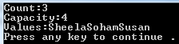
Example: Simple ArrayList
using System;
using System.Collections;
public class NameList {
public static void Main() {
ArrayList list = new ArrayList();
list.Add("Sheela");
list.Add("Soham");
list.Add("Susan");
Console.WriteLine("Count:{0}", list.Count );
Console.WriteLine( "Capacity:{0}", list.Capacity );
Console.Write( "Values:" );
foreach(Object obj in list)
Console.Write( "{0}", obj );
Console.WriteLine();
}}

Slide 36
Sort() methods
void Sort: Sorts the elements in the entire ArrayList.
void Sort(IComparer) Sorts the elements in the entire ArrayList using the specified comparer.
void Sort(Int32, Int32, IComparer): Sorts the elements in a range of elements in ArrayList using the specified comparer.

Slide 37
BinarySearch Members
Members apart from the methods of interfaces
int BinarySearch(Object) : Locates the object in the sorted ArrayList using the default comparer and returns the zero-based index of the element.
The objects in the ArrayList must be of IComparable type
BinarySearch(Object, IComparer): Locates the object in the ArrayList using the specified comparer and returns the zero-based index of the element.
BinarySearch(Int32, Int32, Object, IComparer) : Locates the object in the sorted ArrayList using the specified comparer and returns the zero-based index of the element.

Slide 38
IComparable and IComparer
The sort and the binary search methods relies on how the elements will be ordered in the ArrayList.
The order can be specified in 2 ways:
Using IComparable :
int CompareTo(object obj);
A class implements this interface and provides implementation for CompareTo method which becomes the “default comparer”
Using IComparer :
int Compare (Object x, Object y );
If the “default comparer” of a class is not suited then, another class is created that provides implementation for Compare method which becomes the “specified comparer “.

Slide 39
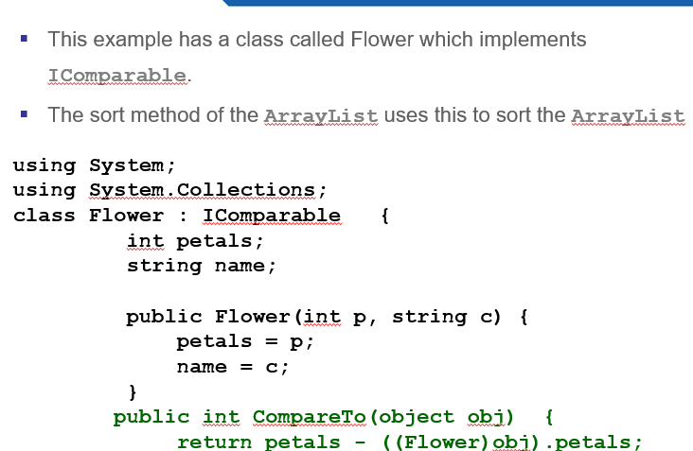

Example: sort using default comparer

Slide 40
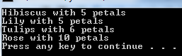
public override string ToString() {
return name + " with " + petals + " petals";
} }
class ArrayListSort {
public static void Main() {
ArrayList flowers = new ArrayList();
flowers.Add(new Flower(5,"Lily"));
flowers.Add(new Flower(10, "Rose"));
flowers.Add(new Flower(5, "Hibiscus"));
flowers.Add(new Flower(6, "Tulips"));
flowers.Sort();
foreach (Flower f in flowers)
Console.WriteLine(f);
} }
Looks for CompareTo() for the objects in the collection

Slide 41
Tell me what?
What happens if the collection contains different types of object?
The compareTo() casts the object into its own type. So if an object of one type is compared to an object of another type, the casting would fail and we end up getting runtime error.
To avoid such issues it is recommended to use type-safe collections using generics.

Slide 42
Example: sort using IComparer
If we want to sort the flowers with respect to their names, then we have to provide another comparison method. This we can do through IComparer.
using System;
using System.Collections;
class Flower: IComparable {
int petals;
public string name;
public Flower(int p, string c) {
petals = p;
name = c; }
public int CompareTo(object obj) {
return petals - ((Flower)obj).petals;
}

Slide 43

public override string ToString() {
return name + " with " + petals + " petals";
} }
class ArrayListSort : IComparer{
public int Compare(Object x, Object y){ return ((Flower)x).name.CompareTo(((Flower)y).name);
}
public static void Main() {
ArrayList flowers = new ArrayList();
flowers.Add(new Flower(5,"Lily"));
flowers.Add(new Flower(10, "Rose"));
flowers.Add(new Flower(5, "Hibiscus"));
flowers.Add(new Flower(6, "Tulips"));
flowers.Sort(new ArrayListSort());
foreach (Flower f in flowers)
Console.WriteLine(f); } }
Note that string class also implements IComparable

Slide 44
Example : BinarySearch
Case 1:
flowers.Sort();
Console.WriteLine(flowers.BinarySearch(new Flower(6, "Tulips")));
→prints 2
Case 2:
flowers.Sort(new ArrayListSort());
int i = flowers.BinarySearch(new Flower(6, "Tulips"), new ArrayListSort()); Console.Write(i);
→prints 3

Slide 45
Hashtable
This class is like a map that has a collection of key-value pairs.
Implements :IDictionary, ICollection, IEnumerable
The collection is organized based on the hash code of the key.
Hashtable uses the hash value of an key object to put the key-value into the bucket. The search happens by first getting the hash code of the key and then looking for the key-value pair in the appropriate bucket.
One object per bucket will lead almost to a linear search. Hence it is very important that hash code generating method is written efficiently.
The size of the Hashtable dynamically increases as elements are added to a it.

Slide 46
Key
The key cannot be Nothing (null). They must be immutable.
They cannot be duplicate.
It is mandated that the object used has key must have one of the following implementations
override the GetHashCode method and the Equals method
Implement IEqualityComparer
Implement the IHashCodeProvider interface and
or the IComparer interface (depreciated, so we will not look at this)
It is important that the hash code methods are implemented properly for the Hashtable to work efficiently.

Slide 47
More
If both set of methods in A, B or C must have similar behaviour. For instance, if GetHashCode() is case sensitive then equals must also be case sensitive.
These method must return same values when called with the same parameters while the key is in the Hashtable.
Also if two things are equal then they must return the same value for hash code.
If the hash codes are equal for 2 objects, it is not necessary for them to be the same; this is a collision, and Equals
Iteration order of Hashtable in C# cannot be determined.
The equality is determined by Equals method (of the key class or IEqualityComparer class) or CompareTo()method of IComparer depending on the context in which it is used.

Slide 48
Constructors
Hashtable() : empty Hashtable that uses the default initial capacity, hash code provider, and comparer
Hashtable(IDictionary d) : contains the elements from the specified dictionary and that uses the default initial capacity, hash code provider, and comparer
Hashtable(int capacity): empty Hashtable that uses the specified initial capacity, hash code provider, and comparer
Hashtable(IEqualityComparer c):empty Hashtable that uses the default initial capacity and specified comparer.
Hashtable(int cap,IEqualityComparer c):empty Hashtable that uses the specified initial capacity and specified comparer.

Slide 49
Members in API
Members apart from the methods of interfaces
Item : Gets or sets the value associated with the specified key.
Keys :Gets an ICollection containing the keys in the Hashtable.
Values: Gets an ICollection containing the values in the Hashtable.
bool Contains(Object key), bool ContainsKey(Object key): both determine if the Hashtable contains a specified key.
bool ContainsValue(Object value): Determines if the Hashtable contains a specifified value.

Slide 50
bool KeyEquals(Object item,Object key): Compares a specific Object with a specific key in the Hashtable.
int GetHash(Object key): Returns the hash code for the specified key.
void Remove(Object key): Removes the element with the specified key from the Hashtable.
IDictionaryEnumerator GetEnumerator() :Returns an IDictionaryEnumerator that iterates through the Hashtable.
Recall that IDictionaryEnumerator has Entry, Key and Value as properties

Slide 51
IEqualityComparer
Methods in IEqualityComparer
bool Equals(Object x,Object y): Determines whether the specified objects are equal.
int GetHashCode(Object obj): Returns a hash code for the specified object.

Slide 52
DictionaryEntry
The key/value pair stored in a DictionaryEntry object.
The foreach statement returns the DictionaryEntry.
Properties
Key
Value

Slide 53
Example: Hashtable
using System;
using System.Collections;
class IDNameMap{
public static void Main(){
Hashtable nlist = new Hashtable();
nlist.Add(11, "Trisha");
nlist.Add(12, "Nisha");
nlist.Add(13, "Nimisha");
nlist.Add(14, "Varsha");
Console.WriteLine(" all keys");
foreach( int i in nlist.Keys )
Console.Write(i+ ", ");

Slide 54
Console.WriteLine("\nall values");
foreach( string s in nlist.Values )
Console.Write(s+ ",");
Console.WriteLine(nlist[13]);
nlist[13]="Disha";
foreach(DictionaryEntry de in nlist ){
Console.WriteLine("Key = {0}, Value = {1}", de.Key, de.Value);
}
//nlist.Add(14,"Varsha");
nlist.Remove(14);
if (!nlist.ContainsKey(14)) {
Console.WriteLine("Key 14 is not found.");
}}}
Unhandled Exception: System.ArgumentException: Item has already been added. Keyin dictionary: '14' Key being added: '14'

Slide 55
Result of execution
all keys
14, 13, 12, 11,
all values
Varsha,Nimisha,Nisha,Trisha,Nimisha
Key = 14, Value = Varsha
Key = 13, Value = Disha
Key = 12, Value = Nisha
Key = 11, Value = Trisha
Key 14 is not found.

Slide 56
Implementing hash code
This example wraps the string names into a class and overrides GetHashCode and equals method to effectively use Hashtable.
using System;
using System.Collections;
class Name{
public String name;
public Name(string nm) { this.name = nm; }
public override int GetHashCode() {
return (name.ToCharArray())[0]; }

Slide 57
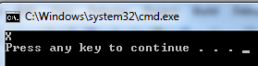
public override bool Equals(object obj) {
Name s = (Name)obj;
return name.Equals(s.name); }
public override string ToString() {
return name; }
}
class HashtableEx{
public static void Main(){
Hashtable nlist = new Hashtable();
nlist.Add(new Name("Trisha"),"V");
nlist.Add( new Name("Nisha"),"VI");
nlist.Add(new Name("Nimisha"), "X");
nlist.Add(new Name("Varsha"),"IV");
nlist.Add(new Name( "Treena"),"II");
Console.WriteLine(
nlist[new Name("Nimisha")]);
}}

Slide 58
SortedList class
Represents a collection of key/value pairs that are sorted by the keys and are accessible by key and by index.
Implements IDictionary, ICollection, Ienumerable
This class also relies on IComparable and IComparer for comparison of keys during the sorts.
That is the elements of a SortedList are sorted by the keys either according to a specific IComparer or according to the IComparable implementation provided.
A SortedList does not allow duplicate keys.

Slide 59
Constructors
SortedList(): has the default initial capacity, and is sorted according to the IComparable interface implemented by each key added to the SortedList object.
SortedList(IComparer c): has the default initial capacity, and is sorted according to the specified IComparer interface.
SortedList(Int32):has the specified initial capacity, and is sorted according to the IComparable interface implemented by each key added to the SortedList object.
SortedList(IComparer, Int32) : has the specified initial capacity, and is sorted according to the specified IComparer interface
SortedList(IDictionary): copied from the specified dictionary and is sorted according to the IComparable interface implemented by each key added to the SortedList object.

Slide 60
Members
The members here also same as that of the Hashtable
DictionaryEntry is used for iteration in the same way as it was used with Hashtable.

Slide 61
Collection with generics
All the collection interfaces have that ‘generic’ counter-part also.
They are defined in System.Collections.Generic Namespace
The generic collection classes are type-safe.
Some other generic classes are
Stack<T> : generic equivalent of the Stack
Queue<T> : generic equivalent of the Queue
List<T> : generic equivalent of the ArrayList
Dictionary <TKey,KValue>: generic equivalent of the Hashtable (Dictionary will throw an exception if you try to reference a key that doesn't exist. Hashtable will just return null.)
SortedList<TKey,KValue>: generic equivalent of the SortedList

Slide 62
Understanding type-safe collection
The example demonstrates the way the generic types (Compare it with non-generic types)
using System;
using System.Collections;
using System.Collections.Generic;
public class TypeSafe{
public static void Main() {
List<string> numbers = new List<string>();
numbers.Add("One");
numbers.Add("Two");
numbers.Add(3); // error-cannot convert from 'int' to 'string'
}}

Slide 63
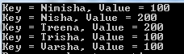
Example: SortedList , KeyValuePair
public static void Main() {
SortedList<String, int> nlist = new SortedList<String, int>();
nlist.Add("Trisha",100);
nlist.Add( "Nisha",200);
nlist.Add("Nimisha", 100);
nlist.Add("Varsha",100);
nlist.Add("Treena",200);
foreach (KeyValuePair<string,int> kvp in nlist){
Console.WriteLine("Key = {0}, Value = {1}",kvp.Key, kvp.Value);
} } }
Similarly Dictionary also uses KeyValuePair

Slide 64
LinkedList<T> class
Represents a doubly linked list.
Important interfaces that this implements are ICollection, IEnumerable<T>, ICollection, IEnumerable, ISerializable, IDeserializationCallback
Constructors:
LinkedList
LinkedList( IEnumerable<T> collection )
Important members are :
AddAfter
AddBefore
AddFirst
AddLast
Find
FindLast
Remove
RemoveFirst
RemoveLast
What these methods do are evident from their names.

Slide 65
Example: LinkedList
using System;
using System.Collections.Generic;
public class LLEx{
public static void Main() {
string[] action = { "sing", "dance", "play" };
LinkedList<string> activity =
new LinkedList<string>(action);
foreach (string word in activity)
Console.Write(word + " ");
Console.WriteLine();
activity.AddFirst("read");

Slide 66
LinkedListNode<string> play = activity.Last;
activity.RemoveLast();
activity.AddFirst(play);
foreach (string word in activity)
Console.Write(word + " ");
Displays
sing dance play
play read sing dance

Slide 67
System.Array
The System.Array type is extended with many generic static methods.
The static generic methods all work with the following four generic delegates defined in the System namespace
public delegate void Action<T>(T t);
public delegate int Comparison<T>(T x, T y);
public delegate U Converter<T, U>(T from);
public delegate bool Predicate<T>(T t);

Slide 68
Comparison in sort() method
public static void Sort<T>(T[] array,Comparison<T> comparison)
This method works with the delegate
public delegate int Comparison<T>(Tx, Ty);

Slide 69
Comparison in sort() method
Example using sort()
using System;
public class Employee{
private int empID;
private string empName;
public Employee(string nm, int id){
this.empID=id;
this.empName=nm;
}
public string Name{
get{return empName;}
set{
System.Console.WriteLine("SET");
if(value!=null)
empName=value; }}
public int ID{
get{return empID;}
set{if(value!=0)
empID=value; }}

Slide 70
Comparison in sort() method
static void Main(){
Employee[] e= {new Employee("Neeta" ,12), new Employee("Surya",11),new Employee("Smita" ,3) };
Array.Sort(e, delegate(Employee e1, Employee e2){
return e1.Name.CompareTo( e2.Name);
});
for(int i=0;i<e.Length;i++)
System.Console.WriteLine("Name is {0},
ID is {1}" ,e[i].Name,e[i].ID);
}
}
or
return e1.ID - e2.ID;

Slide 71
Action in ForEach() method
public static void ForEach<T>(T[] array, Action<T> action);
Uses delegate
public delegate void Action<T>(T t);

Slide 72
Action in ForEach() method
public class Employee{
…
override public String ToString(){
return empName+" ( "+ empID +" ) ";
}
static void Main(){
Employee[] e= {…};
Array.Sort(e, delegate(Employee e1, Employee e2){
return e1.Name.CompareTo( e2.Name);
});
Array.ForEach(e, Console.WriteLine);}}

Slide 73
Converter in ConvertAll()
public static U[] ConvertAll<T,U>(T[] array, Converter<T,U> converter);
Uses the following delegate
public delegate U Converter<T, U>(T from);
This method is used if an array of one type should be converted to an array of another type.

Slide 74
Converter in ConvertAll()
Suppose we have a Trainee class which also has Name and ID as attributes apart from other specific methods of its own.
The following example demonstrates the conversion of Employee array into Trainee array:
class Test{
static void Main(){
Employee[] e= {new Employee("Neeta" ,12), new Employee("Surya",11),new Employee("Smita" ,3) };
Trainee[] t= Array.ConvertAll<Employee,Trainee>(e,delegate(Employee e1){
return new Trainee(e1.Name, e1.ID);
});
Array.ForEach(t, Console.WriteLine);}}

Slide 75
Predicate with find
public static T Find<T>(T[] array,Predicate<T> match);
public static T[] FindAll<T>(T[] array, Predicate<T> match);
public static int FindIndex<T>(T[] array, Predicate<T> match);
All the find methods use the delegate
public delegate bool Predicate<T>(T t);

Slide 76
Predicate with find
static void Main(){
Employee[] e= {new Employee("Neeta" ,12), new Employee("Surya",11),new Employee("Smita" ,3) };
Employee[] s=Array.FindAll(e, delegate(Employee e1){
return e1.Name.StartsWith("S");
});
Array.ForEach(s, Console.WriteLine);
}

Slide 77
IEqualityComparer
Defines methods to support the comparison of objects for equality.
Methods and their description in API:
bool Equals (Object x, Object y): Determines whether the specified objects are equal.
int GetHashCode(Object obj): Returns a hash code for the specified object.

Slide 78
Generics
Generics are a programming construct that enables you to create classes, methods, delegates, and interfaces that work with various data types without specifying the actual type until the code is used.
This results in more flexible, type-safe, and reusable code.
The primary motivation for using generics is to write code that can handle different data types while maintaining compile-time type checking.
This prevents runtime errors and improves code quality by making it more robust and maintainable.

Slide 79
The Need for Generics
Suppose we are building an application that needs to store and manipulate data of different types (e.g., integers, strings, or custom objects).
Without generics, we might be forced to create separate collections and methods for each data type, resulting in code redundancy and decreased maintainability.
With generics, you can create a single collection or method that can work with any data type, allowing for more efficient and concise code.

Slide 80
Generics
Generics are classes, structures, interfaces, and methods that have placeholders (type parameters) for one or more of the types that they store or use.
A generic collection class might use a type parameter as a placeholder for the type of objects that it stores.
The type parameters appear as the types of its fields and the parameter types of its methods.
A generic method might use its type parameter as the type of its return value or as the type of one of its formal parameters.

Slide 81
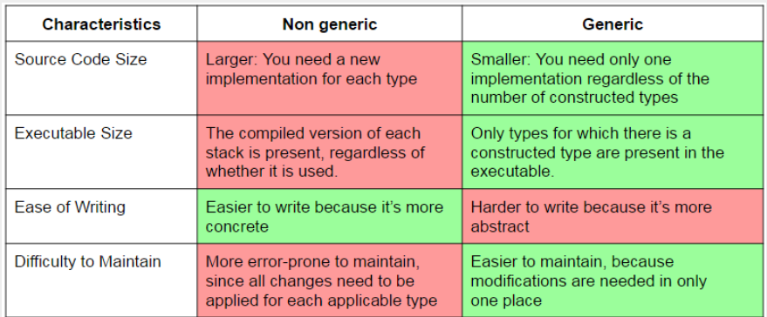
Non-Generic vs Generic

Slide 82
Collections and Generics in c#

Slide 83
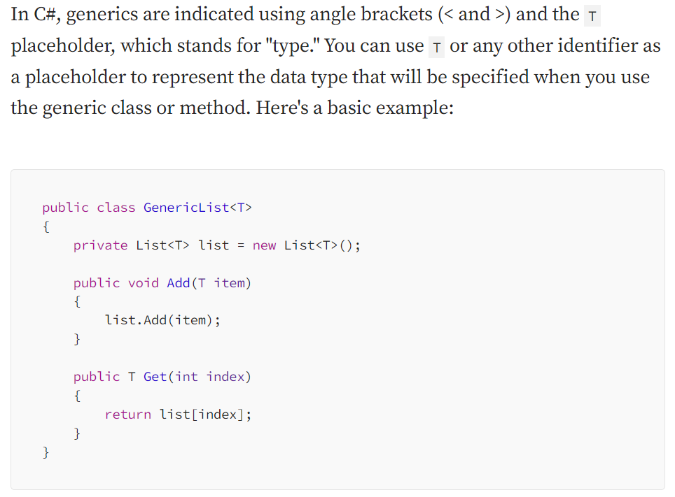
Basics of Generics

Slide 84
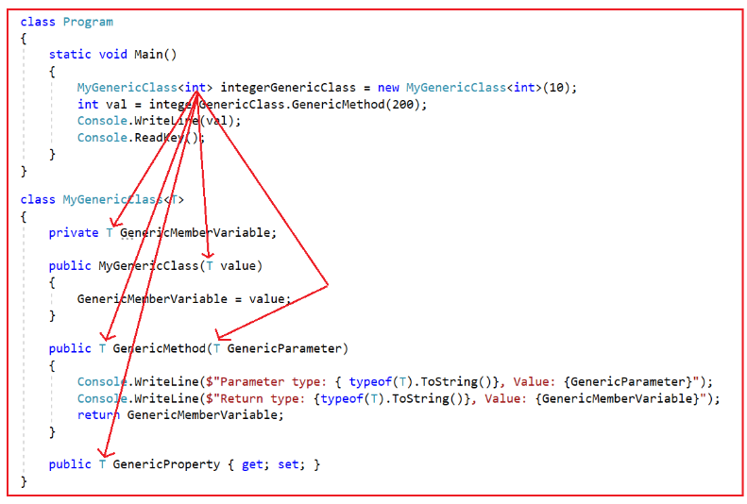
Basics of Generics

Slide 85
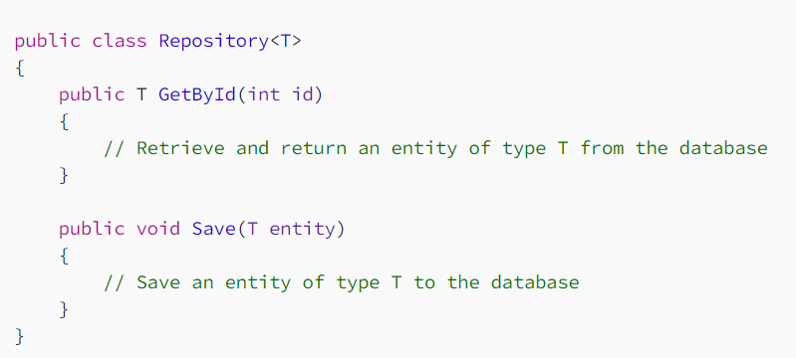
Database Access Generics
Generics can be a powerful tool when working with databases.
For instance, you can create a generic repository class that can perform common database operations on different entities without the need to duplicate code for each entity.

Slide 86
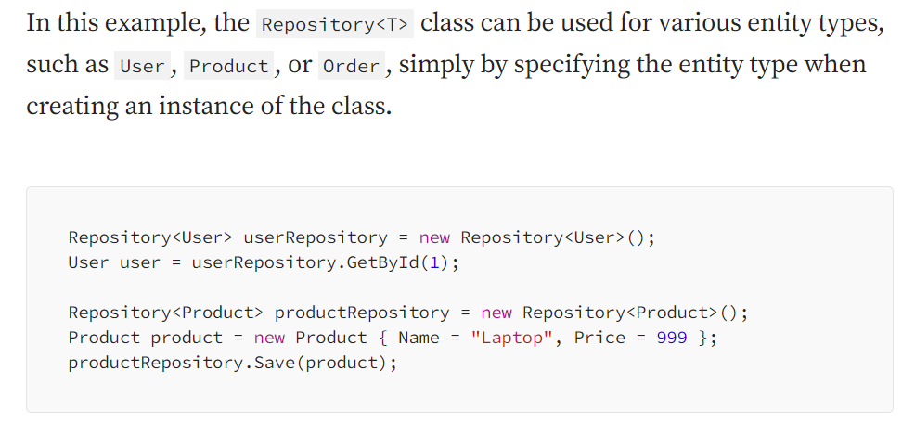
Database Access Generics

Slide 87
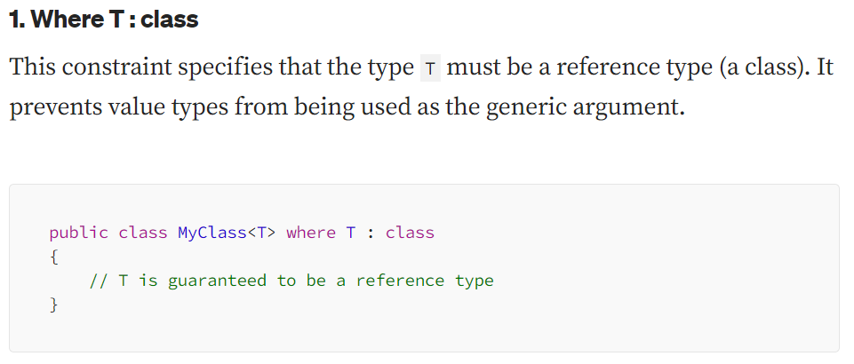
Constraints in Generics

Slide 88
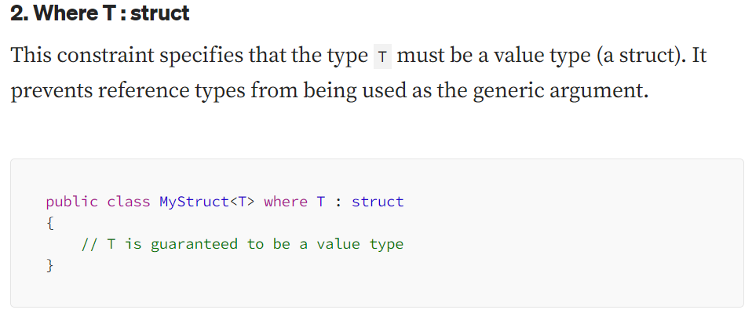
Constraints in Generics

Slide 89
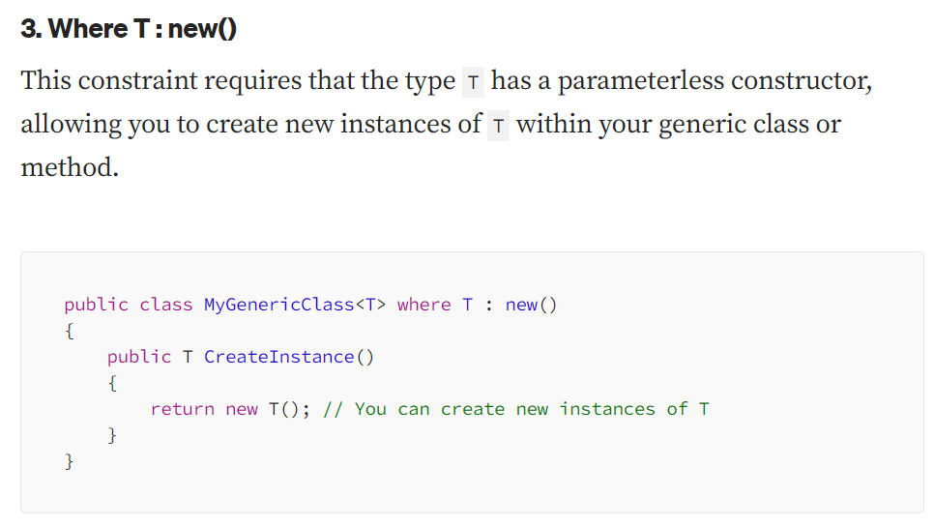
Constraints in Generics

Slide 90
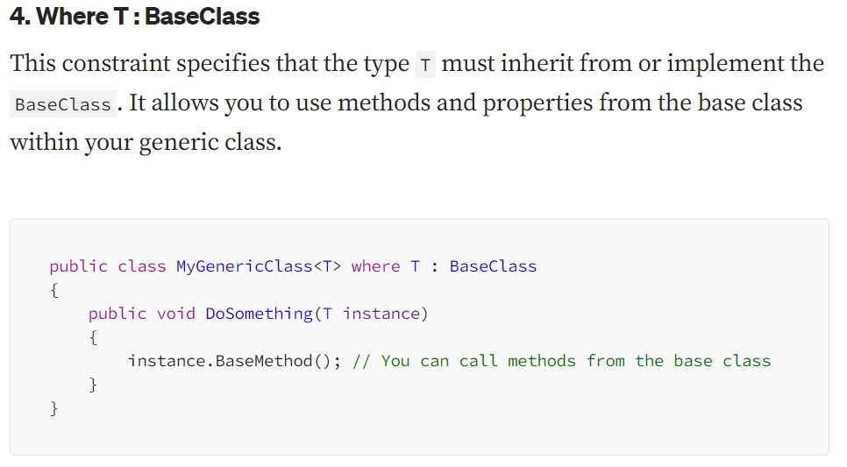
Constraints in Generics

Slide 91
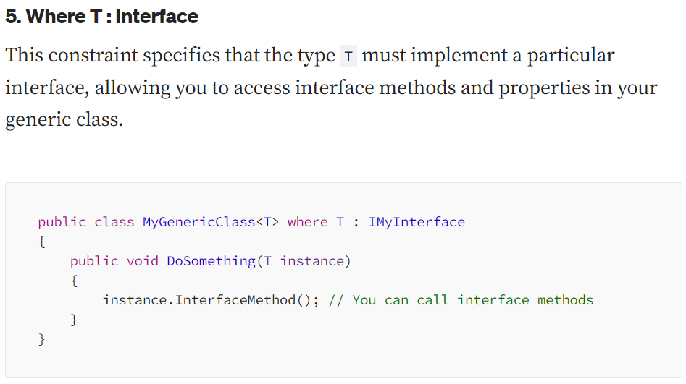
Constraints in Generics

Slide 92
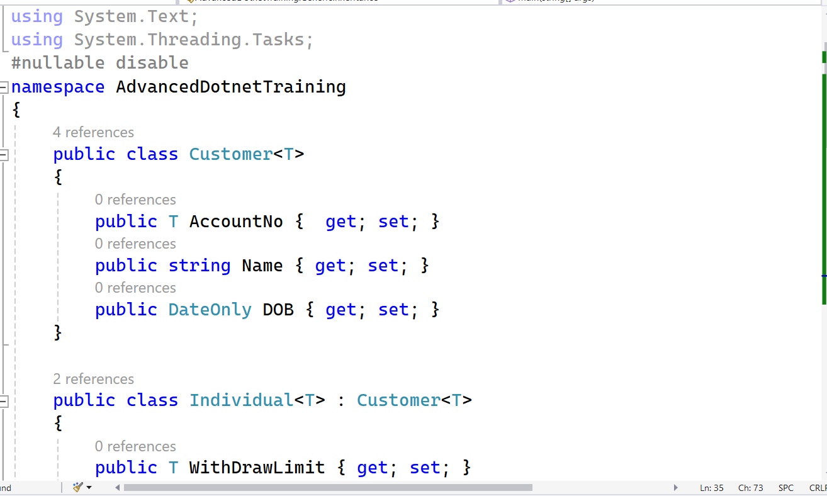
Generic Subclass

Slide 93
Covariance and contravariance in generics
Covariance
Enables you to use a more derived type than originally specified.
You can assign an instance of IEnumerable<Derived> to a variable of type IEnumerable<Base>.
Contravariance
Enables you to use a more generic (less derived) type than originally specified.
You can assign an instance of Action<Base> to a variable of type Action<Derived>.
Invariance
Means that you can use only the type originally specified. An invariant generic type parameter is neither covariant nor contravariant.

Slide 94
Delegates
A delegate is an object which refers to a method or you can say it is a reference type variable that can hold a reference to the methods.
If you click on a Button on a form (Windows Form application), the program will call a specific method.
In simple words, it is a type that represents references to methods with a particular parameter list and return type.
It then calls the method in a program for execution when it is needed.
We can say that the delegates in C# are the Type-Safe Function Pointer.

Slide 95
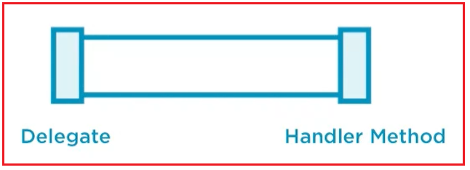
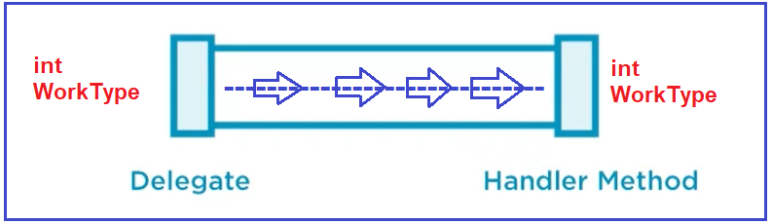
Delegates

Slide 96
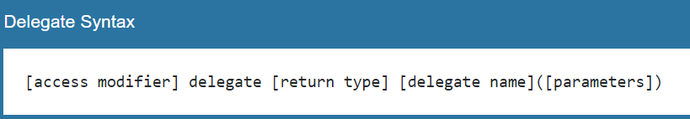
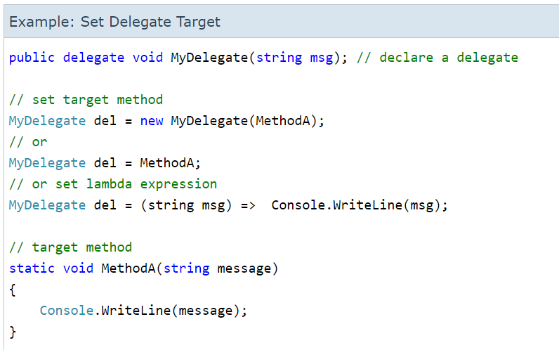
Delegates

Slide 97
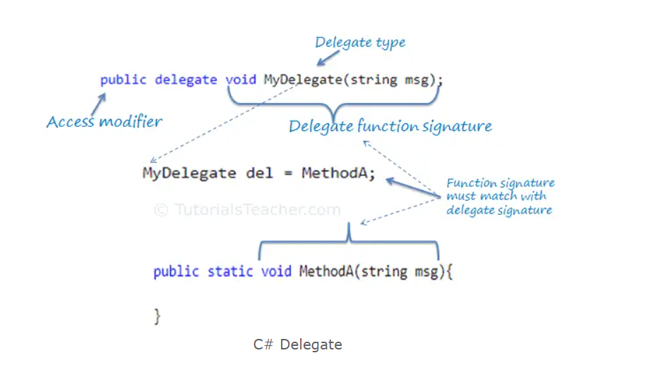
Delegates

Slide 98
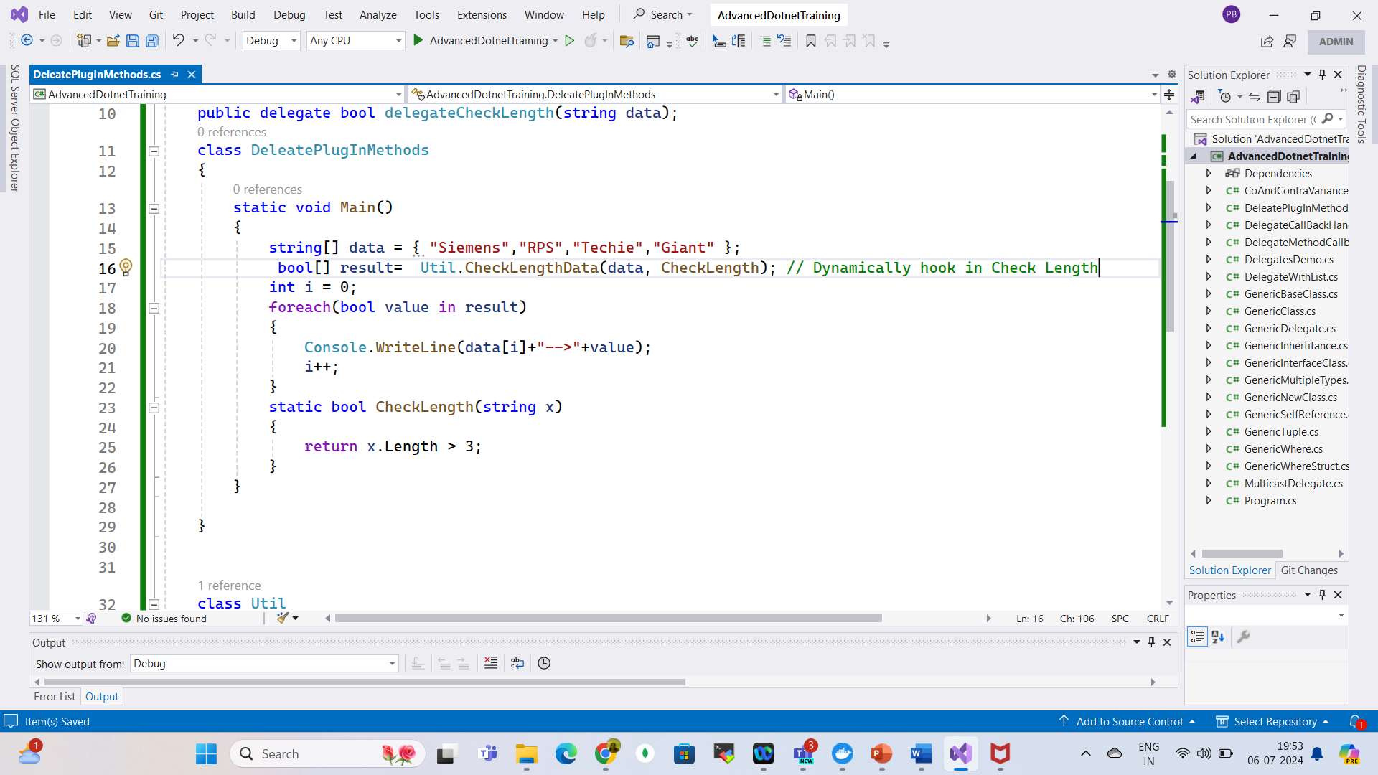
Delegates Plug-in Methods

Slide 99
Generic Delegates
Func Delegate in C#:
Func is a generic delegate present in the System namespace.
Func takes one or more input parameters and returns one out parameter, and the last parameter is considered as a return value.
It can include 0 to 16 input parameters of different types, but it must have one return type.

Slide 100
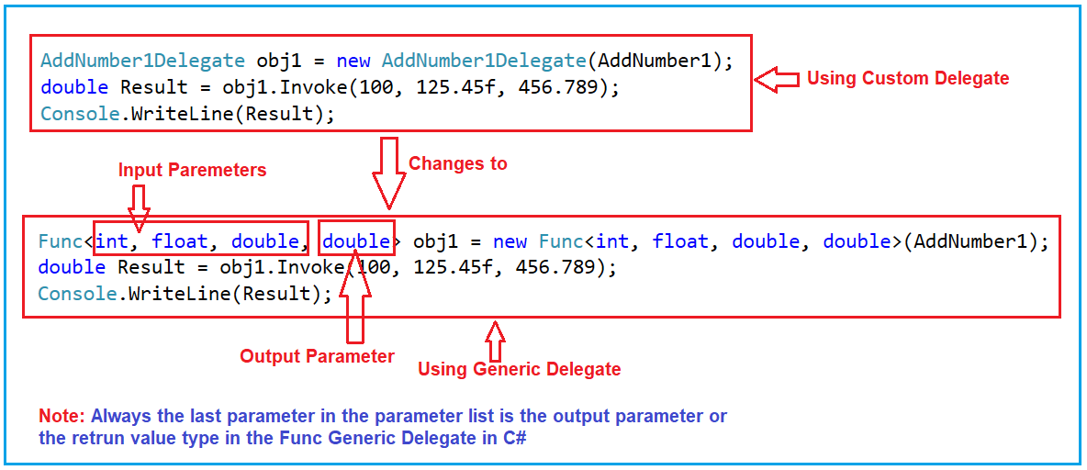
Generic Delegates

Slide 101
Generic Delegates
Action Delegate in C#
Action present in the System namespace.
It takes one or more than one input parameter and returns nothing.
It does not return any value.

Slide 102
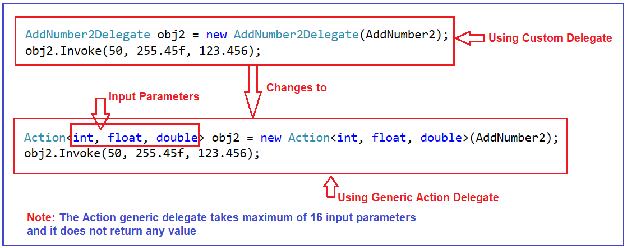
Generic Delegates

Slide 103
Generic Delegates
Predicate Delegate in C#
A predicate delegate is also an inbuilt generic delegate and is present in the System namespace.
predicate is used to verify certain criteria of the method and returns output as Boolean, either True or False.
The predicate can be used with the method, anonymous, and lambda expressions.

Slide 104
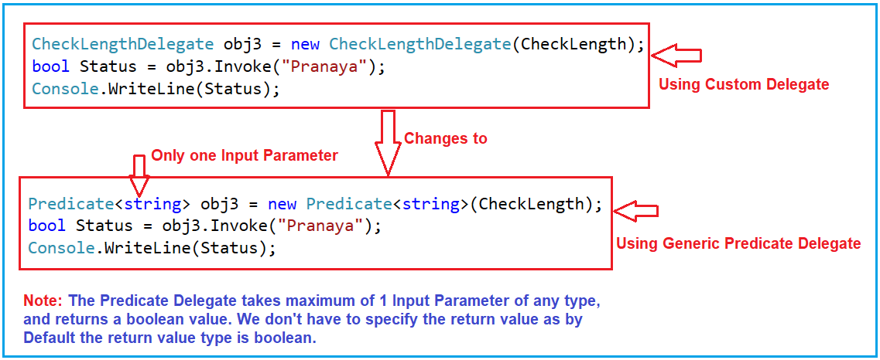
Generic Delegates

Slide 105
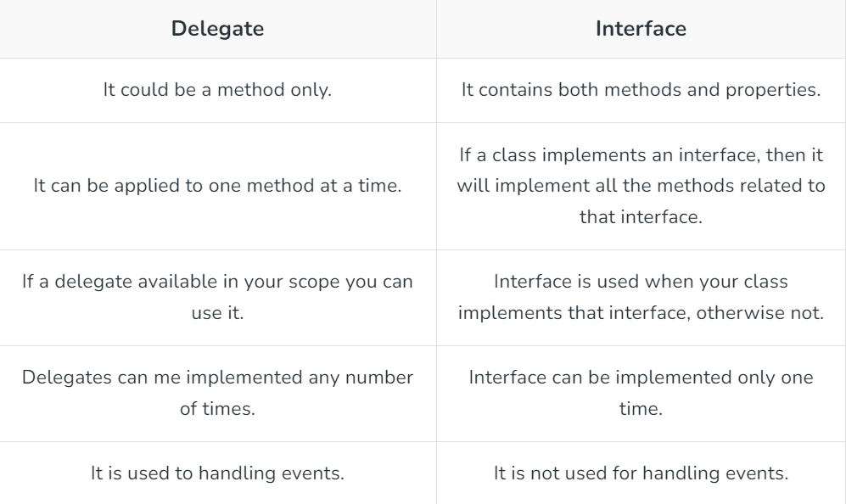
Delegate vs Interface

Slide 106
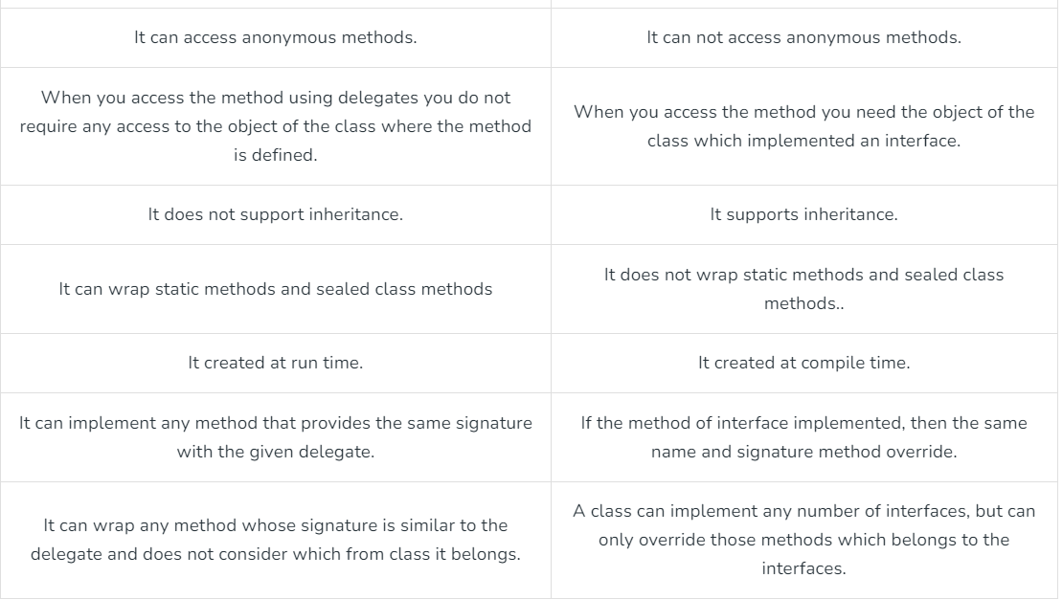
Delegate vs Interface

Slide 107
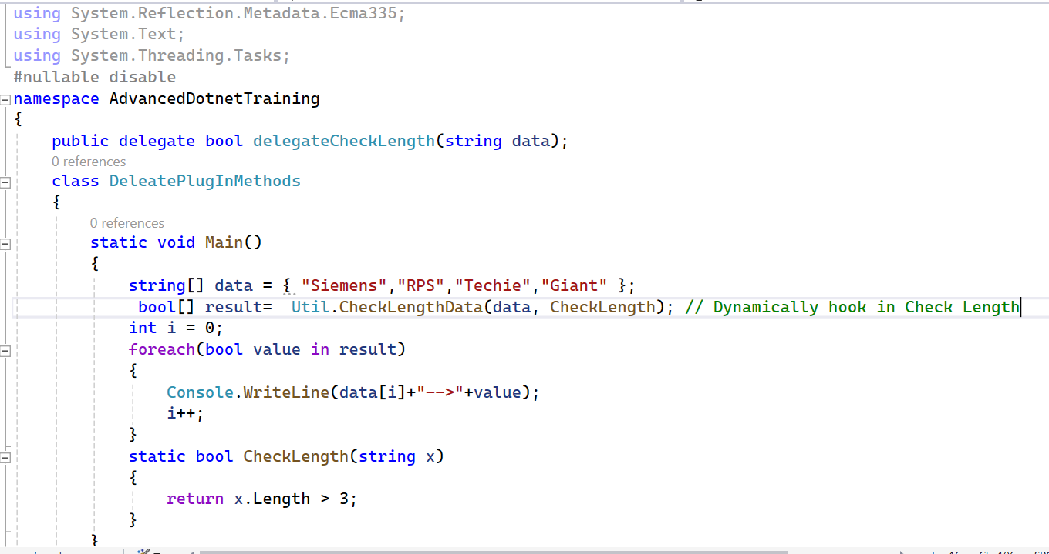

Delegate Compatibility
Check Compatibility

Slide 108
Events
Events enable a class or object to notify other classes or objects when something of action occurs.
The class that sends (or raises) the event is called the publisher and the classes that receive (or handle) the event are called subscribers.
There can be multiple subscribers to a single event.
Typically, a publisher raises an event when some action occurred.
The subscribers, who are interested in getting a notification when an action occurred, should register with an event and handle it.

Slide 109
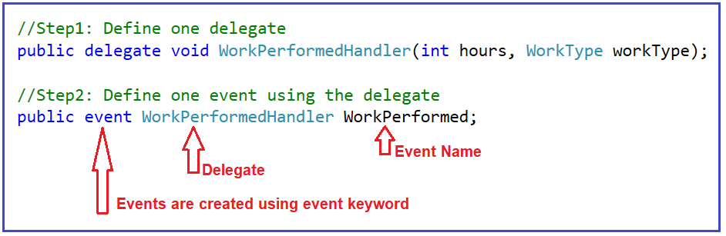
Defining an Event in C#

Slide 110
Events
We created the Work Performed event using the Work Performed Handler delegate.
This is important because an event on its own does not really do anything.
We must have a pipeline or delegate which routes the data from Point A to Point B, that is from Event Raiser to Event Handler or Event Listener.
It is going to be our delegate.
So, events are really wrappers around the delegate.
This is the entire process of defining an event.

Slide 111
Events
An event is a notification sent by an object to signal the occurrence of an action.
The class who raises events is called Publisher, and the class who receives the notification is called Subscriber.
There can be multiple subscribers of a single event.
Typically, a publisher raises an event when some action occurred.
The subscribers get notification when an action occurred.
Subscribers should register with an event and handle it.

Slide 112
Events
If delegates can use their own, then why events?
It is the standard way to provide notification that is the best way to implement publisher and subscriber pattern.
In this case, the listeners can go and attach to the Work Performed event.
But behind the scenes, they are adding themselves to the Invocation List through the Work Performed Handler delegate in the event definition.

Slide 113
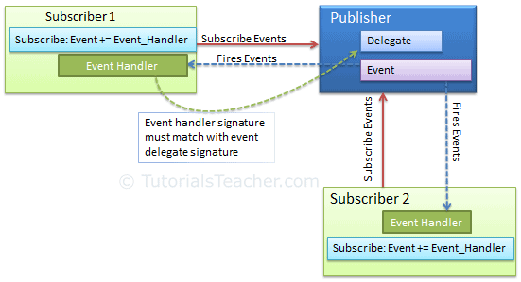
Events

Slide 114
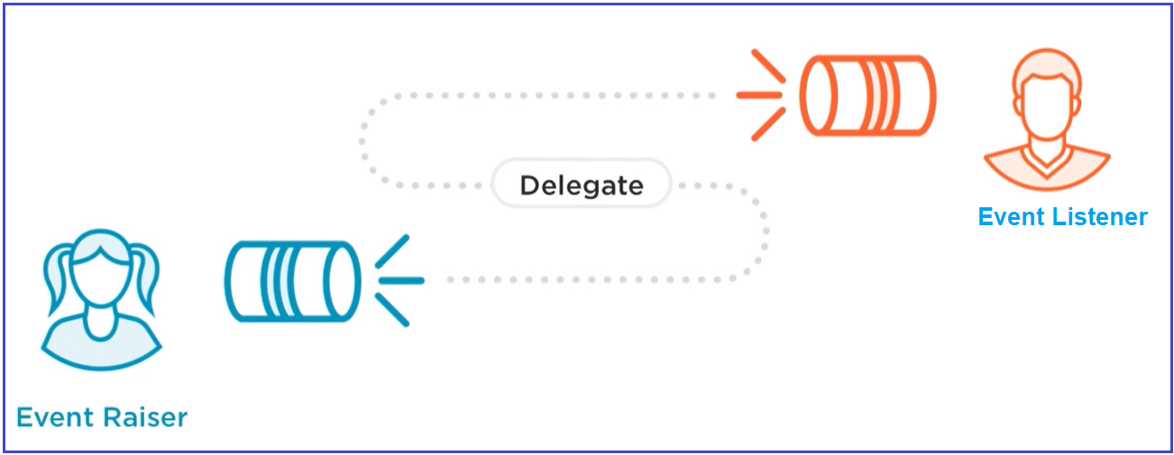
Events

Slide 115
Event Handler
Events and event handlers are generally used in case of a Publisher-Subscriber design pattern.
When ever event has occurred in a particular class, it needs to notify other classes about the event.
The Publisher class has an event which gets invoked on some condition, the subscribers are notified based on their subscription.
One Key benefit of this is the publisher does not need to know anything about who gets notified.

Slide 116

Event Handler
Event Handler is a delegate.
To subscribe to this event a class must have a method with void return type and two input parameters of types :
Object – The source or publisher who invoked the event.
Event Args – An object class which contains the event information.

Slide 117
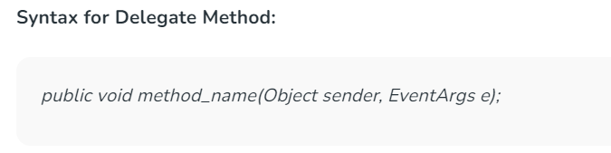
Event Handler
The Subscriber must have a method of same signature as described above to receive the event notification from the publisher.

Slide 118
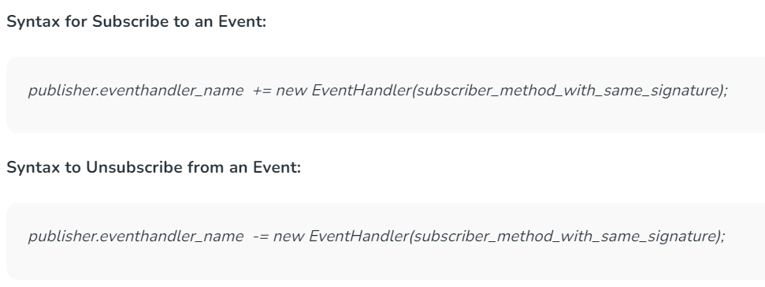
Event Handler

Slide 119
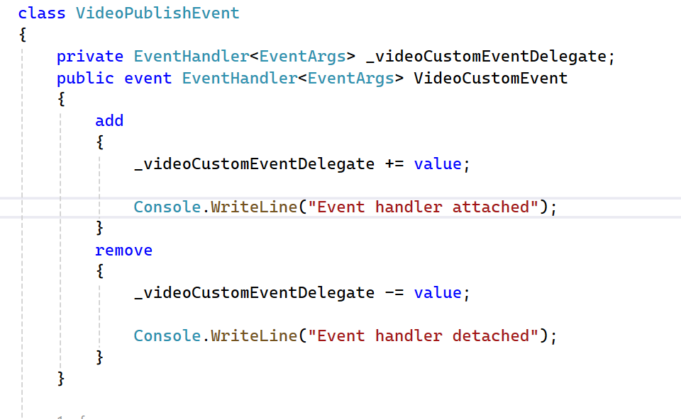
Event Accessors

Slide 120
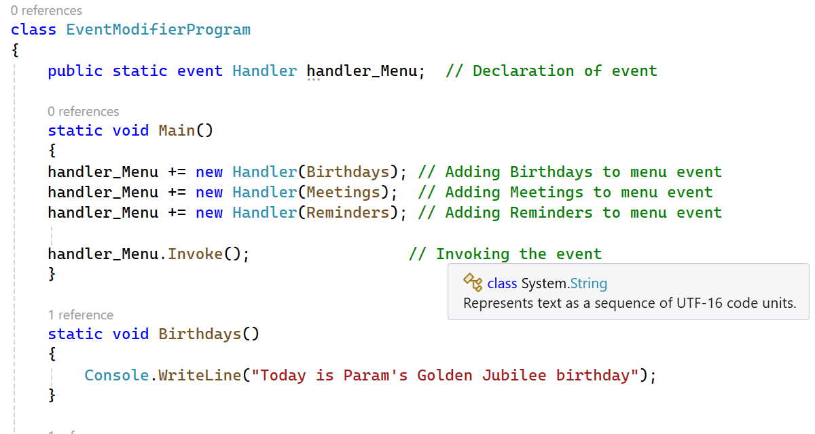
Event Modifiers

Slide 121
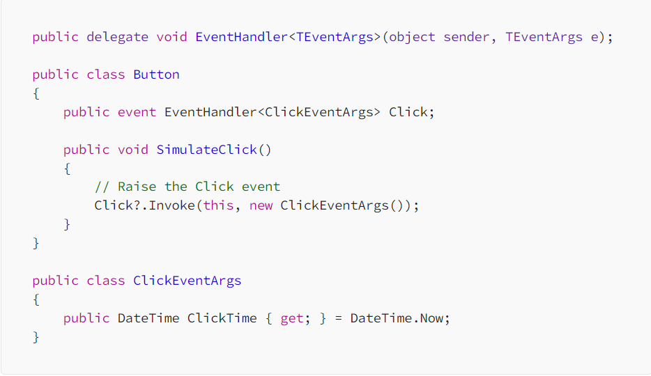
Delegates and Events Generics

Slide 122
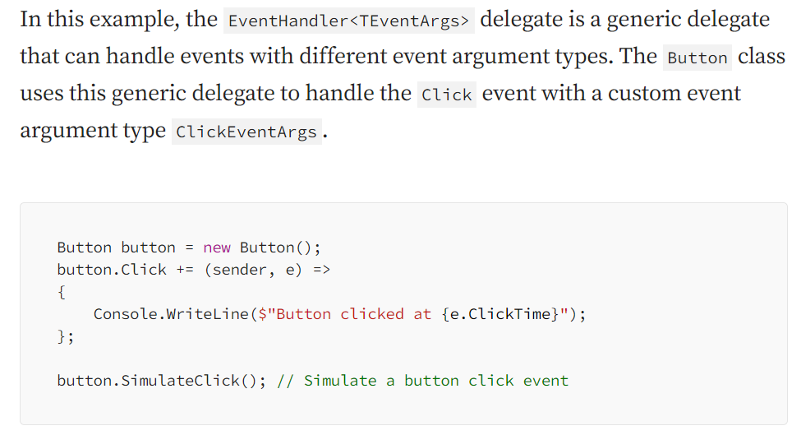
Delegates and Events Generics

Slide 123
Lambda Expressions
Lambda expressions in C# are used like anonymous functions.
Lambda expressions need not to specify the type of the value that you input thus making it more flexible to use.
The ‘=>’ is the lambda operator which is used in all lambda expressions.
The Lambda expression is divided into two parts, the left side is the input, and the right is the expression.

Slide 124
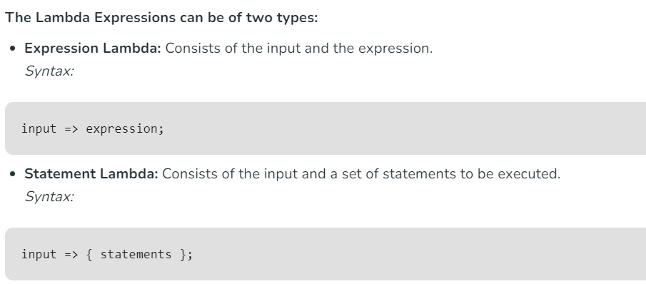
Lambda Expressions

Slide 125
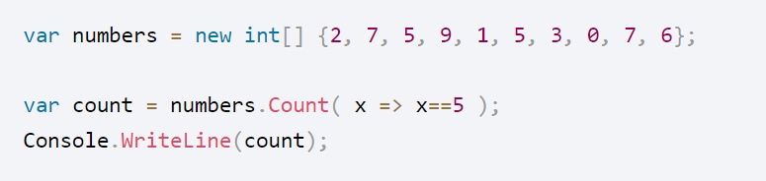

Expression Lambdas
No Body {}

Slide 126
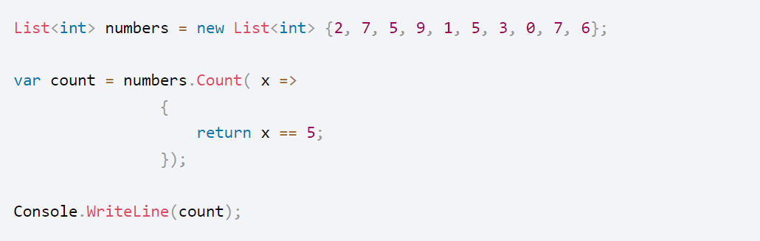

Statement Lambdas

Slide 127
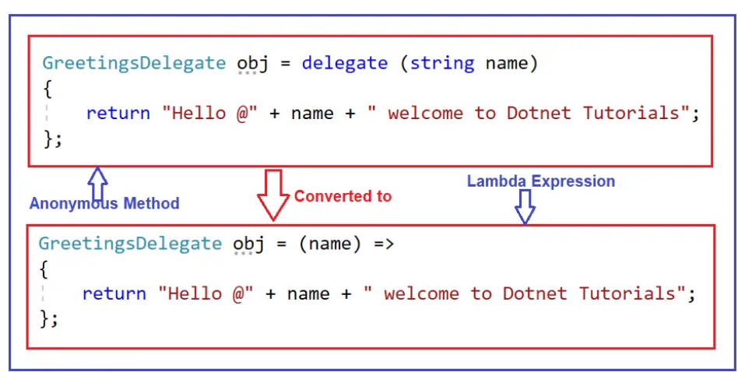
Lambda Expressions in Delegates

Slide 128
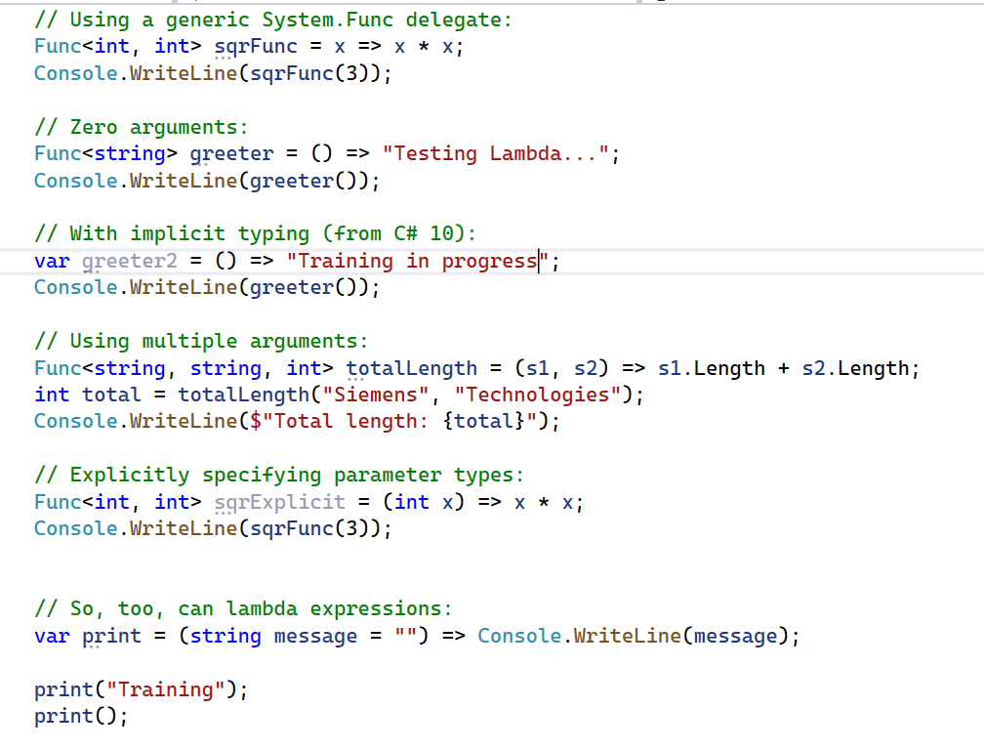
Explicitly Specifying Lambda Parameter and Return Types

Slide 129
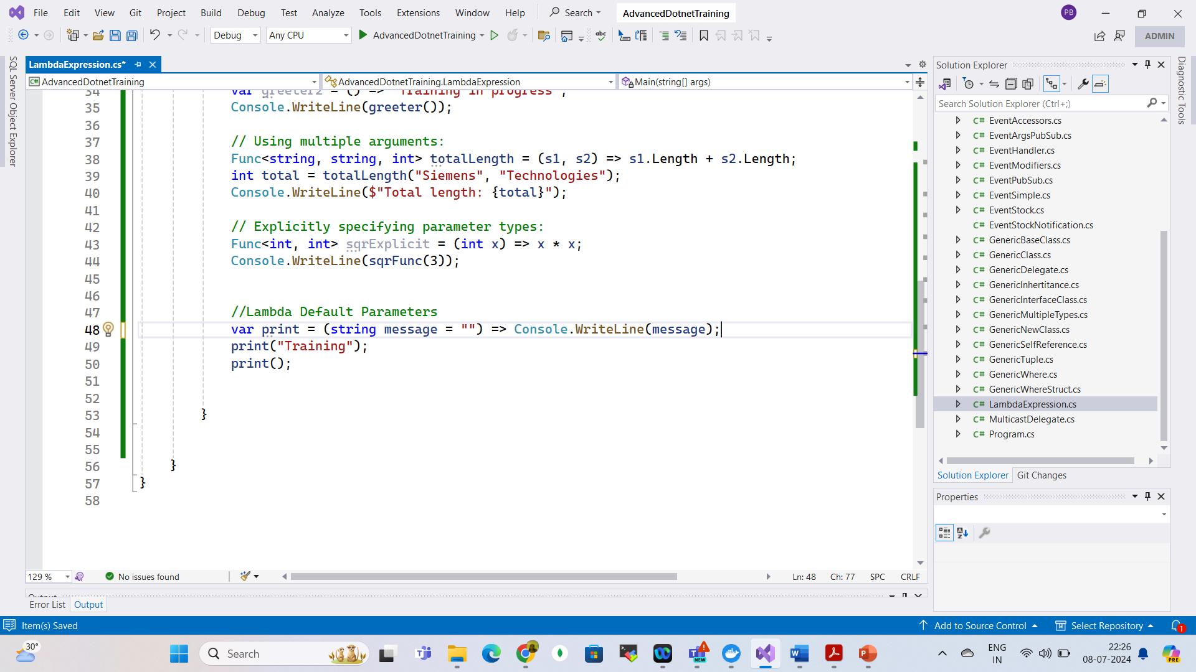
Lambda Expressions - Default Parameters

Slide 130
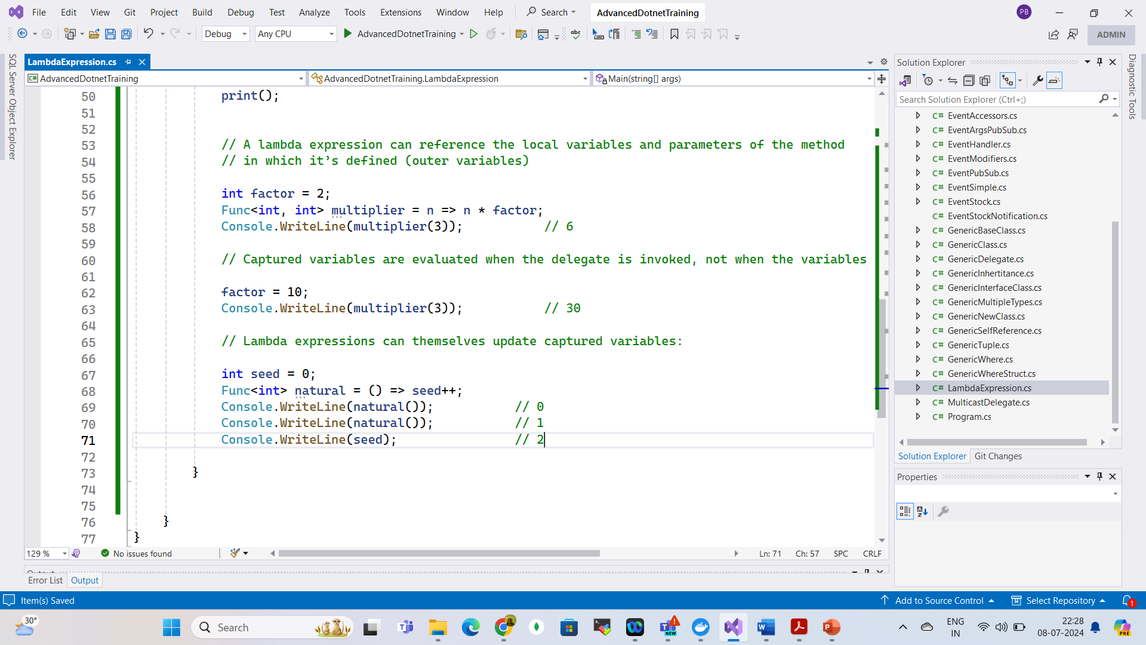
Capturing Outer Variables

Slide 131
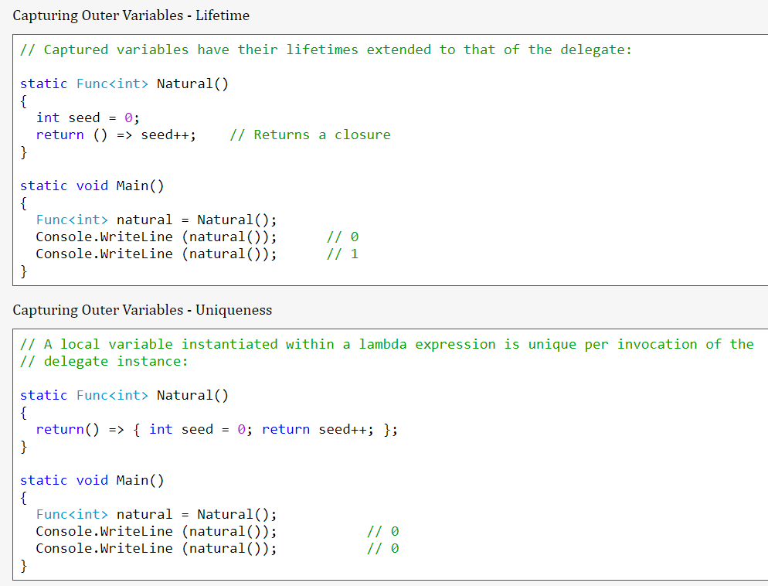
Capturing Outer Variables

Slide 132
Capturing Outer Variables

Slide 133
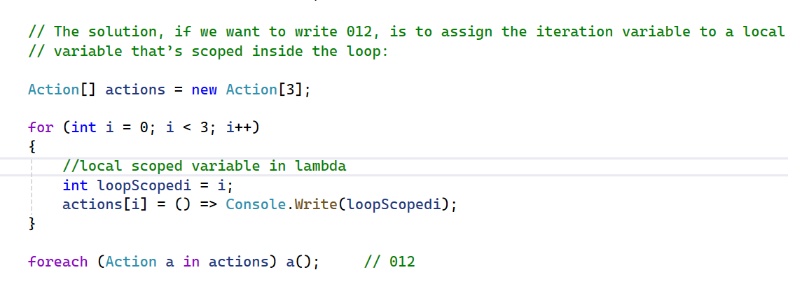
Lambda Expressions Versus Local Methods

Slide 134
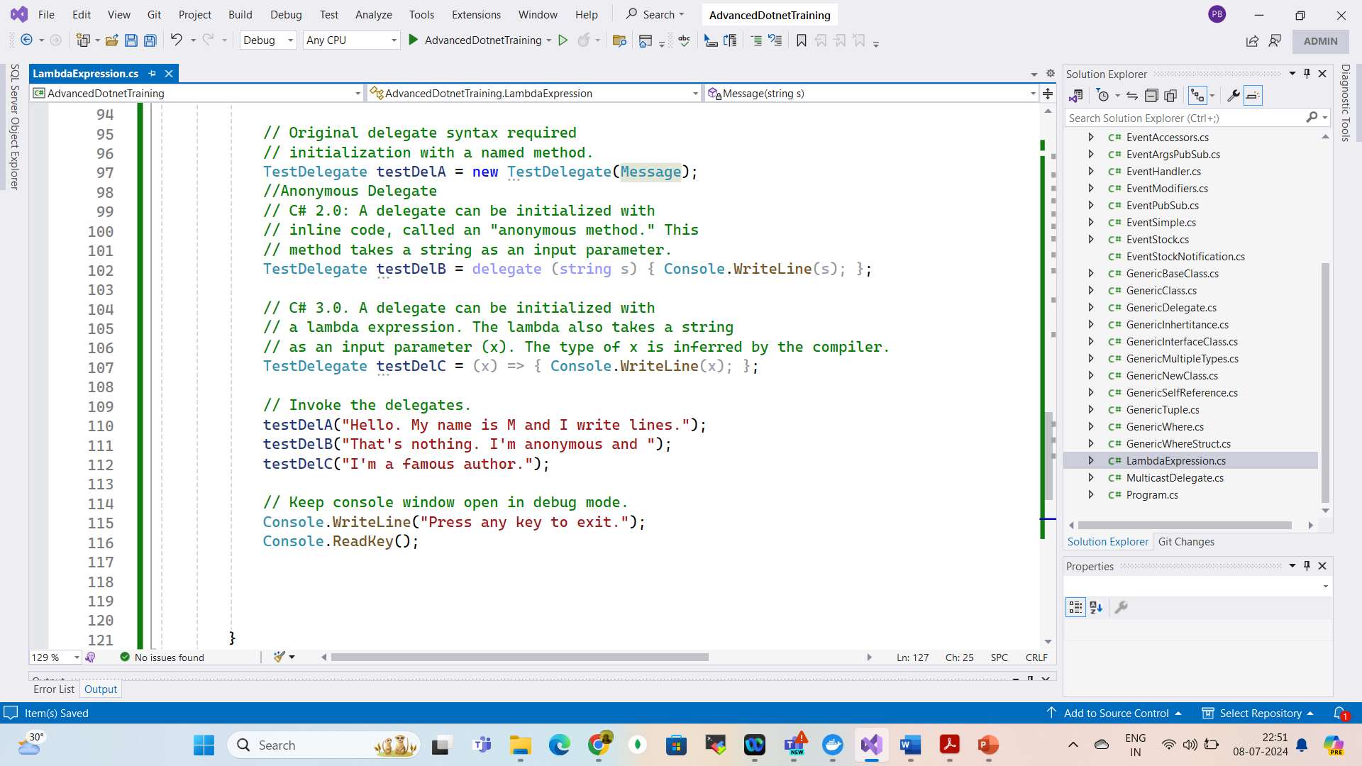
Anonymous Methods

Slide 135
Extension Method
Extension methods make it possible to extend existing types and constructed types with additional methods.
Extension methods are static methods that can be invoked using instance method syntax.
We declare extension methods by using this keyword on the first parameter of the method.
We can declare extension methods only in static class and the extension method itself should be static.

Slide 136

Extension Method

Slide 137

LINQ Queries

Slide 138

Fluent Queries

Slide 139

Extension Methods

Slide 140
Extension Methods

Slide 141


Type Inference & Natural Ordering
Natural Ordering

Slide 142

Other Operators

Slide 143

Query Operations

Slide 144

Query Operations

Slide 145

Deferred Execution

Slide 146


Deferred Execution

Slide 147
Deferred Execution

Slide 148

Sub Queries

Slide 149

Sub Queries

Slide 150

Avoiding Sub Queries

Slide 151

Composite Strategies

Slide 152


Composite Strategies

Slide 153

Composite Strategies

Slide 154

Projection Queries

Slide 155

Projection Queries

Slide 156

Projection Queries

Slide 157

Interpreted Queries

Slide 158

Interpreted Queries

Slide 159

Interpreted Queries

Slide 160
Threading
Threads are the backbone of any software application.
In simple terms, a thread is a single sequence of instructions that a process can execute.
In C#, the System.Threading namespace offers classes that allow you to manipulate threads.
When a C# program starts, it’s a single threaded process by default.
This “main” thread is responsible for executing your code line by line, creating what is known as a single threaded application.
Threads make it possible to execute several program pieces concurrently, enhancing the program’s efficiency.
This brings us to the concept of multithreading.

Slide 161

Thread Lifecycle

Slide 162

Thread Lifecycle

Slide 163
Types of Threads
Foreground Threads: These threads are created using the Thread class in C#.
They are the main threads of an application.
They prevent the application from terminating until all foreground threads have completed their tasks.
A foreground thread can be created by calling the Thread.Start() method.

Slide 164
Types of Threads
Background Threads: These threads are also created using the Thread class in C#, but they are the secondary threads of an application.
They do not prevent the application from terminating, even if they are still running.
A background thread can be created by calling the Thread.Start() method and then setting the IsBackground property of the thread to true before starting it.

Slide 165
Types of Threads
When an application starts, it automatically creates a foreground thread, which is the main thread of the application.
All the threads are background thread by default.
We can change the type of a thread by setting the IsBackground property of the thread.

Slide 166
Types of Threads
Foreground threads are useful when we need to perform a task that is critical to the operation of the application and must be completed before the application can terminate.
For example, a foreground thread might be used to update the user interface or to perform important calculations.

Slide 167
Types of Threads
Background threads are useful when you need to perform a task that is not critical to the operation of the application and can be terminated if the application needs to shut down.
For example, a background thread might be used to download a large file or to perform periodic updates to a database.

Slide 168

Thread Properties

Slide 169

How to create Thread

Slide 170

Thread Lifecycle

Slide 171
Multithreading
In c#, multithreading means executing multiple threads simultaneously to perform multiple tasks at a time.
The perfect example of multithreading is the operating system.
For example, in the windows operating system, we can open multiple applications like excel, word, notepad, browser, etc., to perform multiple tasks simultaneously.
In an operating system, each application process will be taken care by separate threads.

Slide 172

Multi Threading

Slide 173
Joining Threads in C#
In C#, we can create and run multiple threads simultaneously to perform different tasks concurrently.
Sometimes, it is necessary to wait for one thread to complete before starting another thread or wait for all threads to complete before proceeding further.
To achieve this, we can use the following methods to join threads in C#:
Thread.Join(): The Join method of the Thread class waits for the thread to complete its execution before continuing with the execution of the calling thread.
This method blocks the calling thread until the target thread has completed its execution.

Slide 174

Joining Threads in C#

Slide 175

Sleep
In c#, the sleep method is useful to suspend or pause the current thread execution for a specified time.

Slide 176
Synchronization
Synchronization is the act of coordinating concurrent actions for a predictable outcome.
Synchronization is particularly important when multiple threads access the same data.

Slide 177
The synchronization constructs
Exclusive locking
Exclusive locking constructs allow just one thread to perform some activity or execute a section of code at a time.
Their primary purpose is to let threads access shared writing state without interfering with one another.
The exclusive locking constructs are lock, Mutex, and SpinLock.

Slide 178
The synchronization constructs
Nonexclusive locking
Nonexclusive locking lets us limit concurrency.
The nonexclusive locking constructs are Semaphore(Slim) and ReaderWriterLock(Slim)

Slide 179
The synchronization constructs
Signaling
These allow a thread to block until receiving one or more notifications from other thread(s).
The signaling constructs include Manual Reset Event(Slim),AutoResetEvent, CountdownEvent, and Barrier.
The former three are referred to as event wait handles.

Slide 180
Thread Safety and .NET Types
We can use locking to convert thread-unsafe code into thread-safe code.
A good application of this is .NET: nearly all its nonprimitive types are not thread-safe (for anything more than read-only access) when instantiated.
We can use them in multithreaded code if all access to any given object is protected via a lock.

Slide 181

Blocking (Exclusive Lock in Thread)
The lock statement is used to take the mutual-exclusion lock for a specified object.
It executes a specified block and then releases the lock.
The time during which the lock is active, the thread that holds the lock can again take and release the lock.
Note that any other thread cannot access the lock and it waits unless the lock is released.

Slide 182

Blocking (Lock in Thread)

Slide 183

Pass Parameter to Thread

Slide 184

Thread Exception Handling

Slide 185
Thread Priority
In a Multithreading environment, each thread has their own priority.
A thread’s priority shows how frequently a thread gains the access to CPU resources.
Whenever we create a thread in C#, it always has some priority assigned to it.

Slide 186
Thread Priority
A programmer can explicitly assign priority to a thread.
The by default priority of a thread is Normal.
Operating system does not assign the priority of threads.
If a thread has reached a final state, such as Aborted, then this will give ThreadStateException.
If the value specified for a set operation is not a valid ThreadPriority value, then this will give ArgumentException
It is not guaranteed that the thread whose priority is high will executes first and the thread whose priority is low will executes after.
Due to context switching the highest priority thread may execute after lowest priority thread.
When you are assigning a priority to a thread you need to be careful, if you are not doing carefully you may get thread starvation.
The thread priority will always depend upon the process priority or parent container, so by setting the thread priority to highest will not correspond to real-time execution.

Slide 187

Thread Priority

Slide 188
Local Versus Shared State
The CLR assigns each thread its own memory stack.
So that local variables are kept separate.
We define a method with a local variable.
Then call the method simultaneously on the main thread and a newly created thread:

Slide 189
Local State (Thread-Local Storage)
A local state is a variable or data that is confined to a single thread, meaning no other thread can access or modify it.
This approach eliminates the need for synchronization mechanisms since there’s no shared resource.

Slide 190
Local State (Thread-Local Storage)
Examples of Local State
Local variables inside a method: Each thread gets its own stack, so method variables are inherently thread-safe.
Thread-local storage (TLS): Data that is unique to a particular thread.

Slide 191

Local State (Thread-Local Storage)

Slide 192

Local State (Thread-Local Storage)

Slide 193

Local State (Thread-Local Storage)

Slide 194

Local State (Thread-Local Storage)

Slide 195

Local State (Thread-Local Storage)

Slide 196
Shared State (Shared Resources)
A shared state is data accessible by multiple threads.
This requires synchronization to prevent race conditions, deadlocks, and data corruption.
Challenges with Shared State Race conditions:
Multiple threads modifying the same variable concurrently.
Deadlocks: Circular waits due to improper locking.
Performance issues: Excessive locking can reduce concurrency.

Slide 197

Shared State (Shared Resources)

Slide 198

Shared State (Shared Resources)

Slide 199

Shared State (Shared Resources)

Slide 200

Local Versus Shared State

Slide 201

Local Versus Shared State

Slide 202
Thread Signaling
Thread signaling is a mechanism where one thread notifies another thread to start, stop, or continue execution.
This is essential in multithreaded applications to coordinate work between threads.

Slide 203
Why Use Thread Signaling?
Prevents busy waiting (looping until a condition is met).
Ensures thread synchronization in concurrent scenarios.
Useful for producer-consumer and sequential execution patterns.

Slide 204
. Thread Signaling Mechanisms in C#
C# provides various signaling mechanisms, including:
Manual Reset Event & Auto Reset Event – Simple event-based signaling.
Count down Event – Signals when multiple threads have completed.
Barrier – Synchronizes multiple threads at a checkpoint.
Semaphore Slim – Controls thread access to resources.Monitor.
Pulse/Pulse All – Wakes up waiting threads inside a lock.

Slide 205

. Manual Reset Event & AutoReset Event

Slide 206
Barrier
The Barrier class implements a thread execution barrier, allowing many threads to rendezvous at a point in time.
The class is very fast and efficient, and is built upon Wait, Pulse, and spinlocks.
To use this class:
1. Instantiate it, specifying how many threads should partake in the rendezvous.
2. Have each thread call SignalAndWait when it wants to rendezvous.
Instantiating Barrier with a value of 3 causes SignalAndWait to block until that method has been called three times.
It then starts over: calling SignalAndWait again blocks until called another three times.
This keeps each thread “in step” with every other thread.

Slide 207
Barrier

Slide 208

Barrier

Slide 209

Choosing the Right Signaling Mechanism

Slide 210
Threading in Rich Client Applications
Rich client applications, such as WPF (Windows Presentation Foundation) and WinForms (Windows Forms), require careful threading to maintain UI responsiveness while performing background operations.

Slide 211
Threading in Rich Client Applications
The UI Thread is single-threaded – Running time-consuming tasks on the UI thread freezes the UI.
Need for Background Processing – Heavy computations, network requests, and database operations should run in background threads to keep the UI responsive.
Thread Synchronization is Required – UI elements can only be updated from the UI thread (invoking updates from worker threads requires synchronization).

Slide 212

Threading in Rich Client Applications

Slide 213
Synchronization Contexts
It allows switching back to the UI thread from a background thread.
It ensures thread synchronization without explicitly using Invoke() (WinForms) or Dispatcher (WPF).
It's especially useful in UI applications (WinForms/WPF) to avoid cross-thread exceptions.

Slide 214

Synchronization Contexts

Slide 215

Thread Pool
The Thread Pool in C# is a managed pool of worker threads that efficiently handles background tasks, reducing the overhead of creating and destroying threads manually.

Slide 216
Why Use the Thread Pool?
✅ Automatic thread management – No need to create/destroy threads manually. ✅ Efficient resource utilization – Uses a pool of pre-created threads. ✅ Prevents excessive thread creation – Limits the number of concurrent threads. ✅ Ideal for short-lived tasks – Great for I/O-bound and CPU-bound operations.

Slide 217

When to Use the Thread Pool

Slide 218
Thread Pool
We cannot set the Name of a pooled thread, making debugging more difficult.
Pooled threads are always background threads.

Slide 219

Parallel vs Asynchronous
Parallel execution means that you have multiple threads doing different job and not knowing about each other.
Asynchronous execution refers to having single thread switching between different jobs.

Slide 220
Task
Task in C# represents an asynchronous operation that runs on the Thread Pool.
It is a higher-level abstraction over threads and is the preferred way to perform concurrent and asynchronous programming.

Slide 221
Why Use Task Instead of Thread?
✅ Automatic thread management – Uses the Thread Pool instead of creating new threads manually.
✅ Built-in async support – Works seamlessly with async/await.
✅ Supports cancellation & continuations – Can be canceled or chained easily.
✅ Efficient for short-lived operations – Unlike Thread, Task is optimized for background tasks.

Slide 222

Task

Slide 223
Creating and Running Tasks
Tasks can be created using:
Task.Run()
Task.Factory.StartNew()
new Task().Start()

Slide 224

Creating and Running Tasks

Slide 225

Returning Values From Task

Slide 226

Waiting for a Task (Wait vs. await)

Slide 227

Waiting for a Task (Wait vs. await)

Slide 228

Running Multiple Tasks in Parallel

Slide 229

Task Continuations (ContinueWith)

Slide 230

Task Cancellation (CancellationToken)

Slide 231

Task vs Thread vs Thread Pool

Slide 232
Differences Between Task And Thread
The Thread class is used for creating and manipulating a thread in Windows.
A Task represents some asynchronous operation and is part of the Task Parallel Library, a set of APIs for running tasks asynchronously and in parallel.
The task can return a result.
There is no direct mechanism to return the result from a thread.
Task supports cancellation using cancellation tokens. But Thread doesn't.
A task can have multiple processes happening at the same time.
Threads can only have one task running at a time.

Slide 233
Differences Between Task And Thread
We can easily implement Asynchronous using ’async’ and ‘await’ keywords.
A new Thread() is not dealing with Thread pool thread, whereas Task does use thread pool thread.
A Task is a higher level concept than Thread.

Slide 234

Entering Thread Pool
The easiest way to explicitly run something on a pooled thread is to use Task.Run
// Task is in System.Threading.Tasks
Task.Run (() => Console.WriteLine ("Hello from the thread pool"));

Slide 235
Task
The easiest way to start a Task backed by a thread is with the static method Task.Run.
Simply pass in an Action delegate:
Task.Run (() => Console.WriteLine (“Rocking…"));

Slide 236
Task
Calling Task.Run in this manner is same as starting a thread as follows
new Thread (() => Console.WriteLine (“Rock")).Start();
Task.Run returns a Task object that we can use to monitor its progress, rather like a Thread object.

Slide 237

Wait

Slide 238

Returning values
Task has a generic subclass called Task<TResult>, which allows a task to emit a return value.
We can obtain a Task<TResult> by calling Task.Run with a Func <TResult> delegate instead of an Action:
Task<int> task = Task.Run (() => { Console.WriteLine (“Rock"); return 3; }
int result = task.Result; // Blocks if not already finished
Console.WriteLine (result); //

Slide 239

Exceptions

Slide 240

Creating a continuation for a single antecedent

Slide 241

Scheduling Different Continuation Tasks

Slide 242

Parallel Programming
Nowadays, multicore processors (2 cores, 4 cores, 8 cores …) become very popular.
Even they can be found in most devices.

Slide 243

Parallel Programming

Slide 244

Parallel Programming

Slide 245

Parallel Programming

Slide 246

Parallel Programming

Slide 247

Parallel Programming

Slide 248

Parallel Programming

Slide 249


PLINQ

Slide 250

PLINQ

Slide 251

PLINQ AS Ordered

Slide 252

PLINQ AS Ordered

Slide 253

PLINQ AS Ordered

Slide 254

Parallel Invoke

Slide 255

Parallel Cancellation

Slide 256

Parallel Cancellation

Slide 257

Parallel Cancellation

Slide 258
Common Pitfalls and Best Practices
Overuse of Generics
Using generics for every scenario may lead to code that is overly complex and hard to understand.
It’s essential to strike a balance and use generics where they genuinely add value.
Avoid Tight Coupling
Avoid creating overly complex generic classes that are tightly coupled with various types.
Tight coupling can make your code less maintainable and harder to test.

Slide 259
Common Pitfalls and Best Practices
Provide Clear Documentation
When creating generic classes or methods, document their usage and constraints clearly.
Good documentation helps other developers understand how to use your generics effectively.
Test with Multiple Types
When designing generic classes or methods, thoroughly test them with various data types to ensure they work correctly and safely under different scenarios.

Slide 260
Common Pitfalls and Best Practices
Consider Code Duplication
Generics can be an excellent way to reduce code duplication,
But be cautious not to overcomplicate your codebase. Sometimes, it might be better to have separate non-generic implementations for specific cases.

Slide 261
File Handling
• File Handling in C#
• FileStream Class in C#
• StreamReader and StreamWriter in C#
• File Class in C#
• TextWriter and TextReader in C#
• BinaryWriter and BinaryReader in C#
• StringWriter and StringReader in C#
• FileInfo Class in C#
• DirectoryInfo Class in C#
• Export and Import Excel Data in C#

Slide 262
File Handling
Generally, we use the file to store data.
The term File Handling in C# refers to the various operations that we can perform on a file such as creating a file, reading data from the file, writing data into the file, appending the file, etc.
Generally, we mostly perform three basic operations on a file: reading data from a file, writing data to a file and appending data to a file.
Reading: This operation is the basic read operation where the data is going to be read from a file.
Writing: This operation is the basic write operation where the data is going to be written to a file.

Slide 263
File Handling
By default, all existing contents are removed from the file, and new content is written in the file.
Appending: This operation is the same as the write operation where the data is going to be written to a file.
The only difference between Write and Append is that the existing data in the file will not be overwritten.
With Append, the new data is going to be added at the end of the file.

Slide 264
Stream
When we open a file for reading or writing, it becomes stream.
Stream is a sequence of bytes traveling from a source to a destination over a communication path.
The two basic streams are input and output streams. Input stream is used to read and output stream is used to write.
The System.IO namespace includes various classes for file handling.
The parent class of file processing is stream.
Stream is an abstract class, which is used as the parent of the classes that implement the necessary operations.
The primary support of a file as an object is provided by a .NET Framework class called File.
This static class is equipped with various types of (static) methods to create, save, open, copy, move, delete, or check the existence of a file.

Slide 265

System.IO Namespace in C#

Slide 266

Directory Search
DirectoryInfo dir

Slide 267

Overview of Classes

Slide 268
What is File Stream Class in C#?
The File Stream Class in C# provides a stream for file operations.
It can be used to perform both Synchronous and Asynchronous Read and Write operations.
With the help of File Stream Class, we can easily read and write data into files.
To use File Stream Class in C#, first of all, we need to include the System.IO namespace.
Then we need to create an instance of the File Stream class either to create a new file or to open an existing file.
If we go to the definition of File Stream class, then we will see that there are many overloaded versions of Constructors available.

Slide 269

What is File Stream Class in C#?

Slide 270

What is File Stream Class using File?

Slide 271

What is File Stream Class using File?

Slide 272

What is File Stream Class using File?

Slide 273

What is File Stream Class in C#?

Slide 274

What is File Stream Write in C#?

Slide 275

What is File Stream Read in C#?

Slide 276

StreamReader and StreamWriter in C#

Slide 277

StreamReader and StreamWriter in C#

Slide 278
Text Writer and Text Reader
Text Writer is an abstract class belonging to the System.IO namespace.
It is used to write a sequential series of characters into a file.
It is the base class of Stream Writer and String Writer which is used to write characters to streams and strings respectively.
By default, it is not thread-safe.
As it is an abstract class, its object cannot be created. Any class implementing Text Writer must minimally implement its Write(Char) method to create its useful instance.

Slide 279

Text Writer and Text Reader

Slide 280

Text Writer and Text Reader

Slide 281

Text Writer and Text Reader

Slide 282
Binary Writer and Binary Reader in C#
The Binary Writer class in C# is used to write Primitive type data types such as int, uint, or char in the form of binary data to a stream.
It is present under the System.IO namespace.
As its name says Binary Writer writes binary files that use a specific data layout for its bytes.
The Binary Writer in C# creates a binary file that is not human-understandable, but the machine can understand it.
It supports writing strings in a specific encoding.
In order to create an object of Binary Writer, we need to pass an object of Stream to the constructor of the Binary Writer class.
The Binary Writer class in C# provides methods that simplify writing primitive data types to a stream.
If you don’t provide types of encoding while creating objects, then default encoding UTF-8 will be used.

Slide 283
Binary Writer and Binary Reader in C#
The Binary Writer class in C# is used to write Primitive type data types such as int, uint, or char in the form of binary data to a stream.
It is present under the System.IO namespace.
As its name says Binary Writer writes binary files that use a specific data layout for its bytes.
The Binary Writer in C# creates a binary file that is not human-understandable, but the machine can understand it.
It supports writing strings in a specific encoding.
In order to create an object of Binary Writer, we need to pass an object of Stream to the constructor of the Binary Writer class.
The Binary Writer class in C# provides methods that simplify writing primitive data types to a stream.
If you don’t provide types of encoding while creating objects, then default encoding UTF-8 will be used.

Slide 284

Binary Writer and Binary Reader in C#

Slide 285

Binary Writer and Binary Reader in C#

Slide 286
String Writer and String Reader in C#
The String Writer Class in C# is derived from the TextWriter class.
This String Writer class is mainly used to manipulate strings rather than files.
The String Writer class enables us to write a string either synchronously or asynchronously.
So, we can write a character either with Write(Char) or Write Async(Char) method.
We can write a string with Write(String) or Writer Async(String) method.

Slide 287
String Writer and String Reader in C#
The text or information written by String Writer class is stored inside a StringBuilder.
The Text namespace and the strings can be built efficiently using the StringBuilder class because strings are immutable in C# .
Write and WriteLine methods provided by String Writer help us to write into the object of StringBuilder.
StringBuilder class stores the information written by String Writer class.

Slide 288

String Writer and String Reader in C#

Slide 289
Export and Import Excel Data in C#
NPOI is an Open-Source library that can help us perform read and write operations on XLS, DOC, and PPT file extensions.
This NPOI Library is the .NET version of the POI Java project at http://poi.apache.org/.
This NPOI Library covers almost all the important features of Excel, like styling, formatting, data formulas, extracting images, etc.
And the most important thing is that it does not require Microsoft Office to be installed on the server.

Slide 290

Export and Import Excel Data in C#

Slide 291

Export and Import Excel Data in C#

Slide 292

Export and Import Excel Data in C#

Slide 293
Questions

Slide 294
Module Summary
Microservices using docker and Kubernets.
Message, Channel and Adapter
Understood the different Component Integration
Understood the Event-Driven Architecture

